Slide 1
BYF
CONSTRUCTION CLUB
Session 5

Slide 2
Greeting
Clump
Students will form groups or “clumps” based on the leader’s instructions.
Example: groups of 3!
Anyone not in a “clump” is out.
When two students are left, play Hammer/Blueprint/Architect to determine winner.

Slide 3
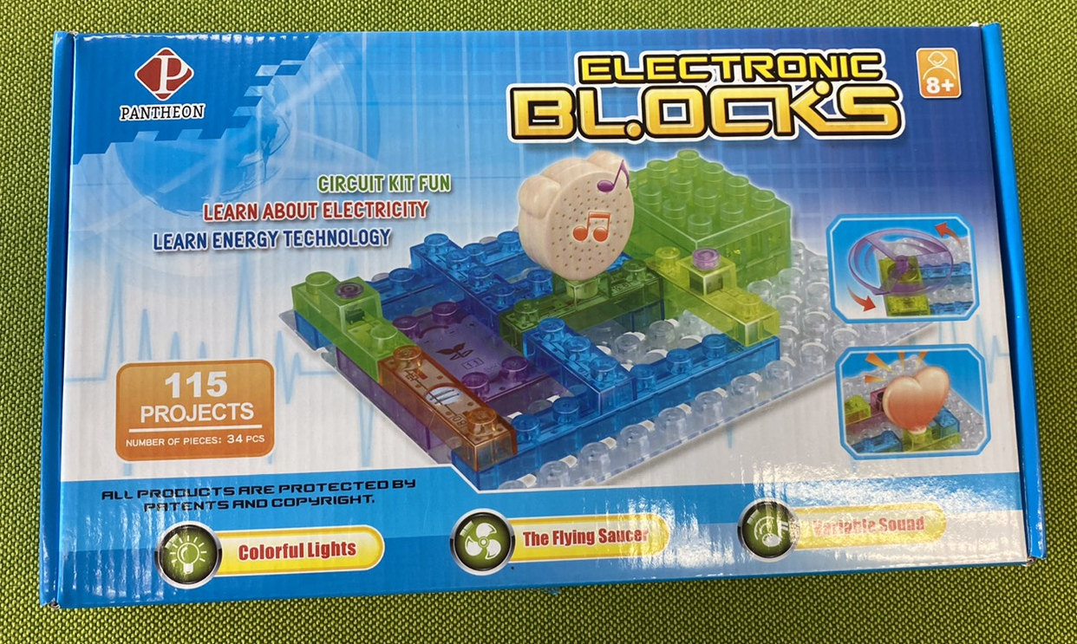
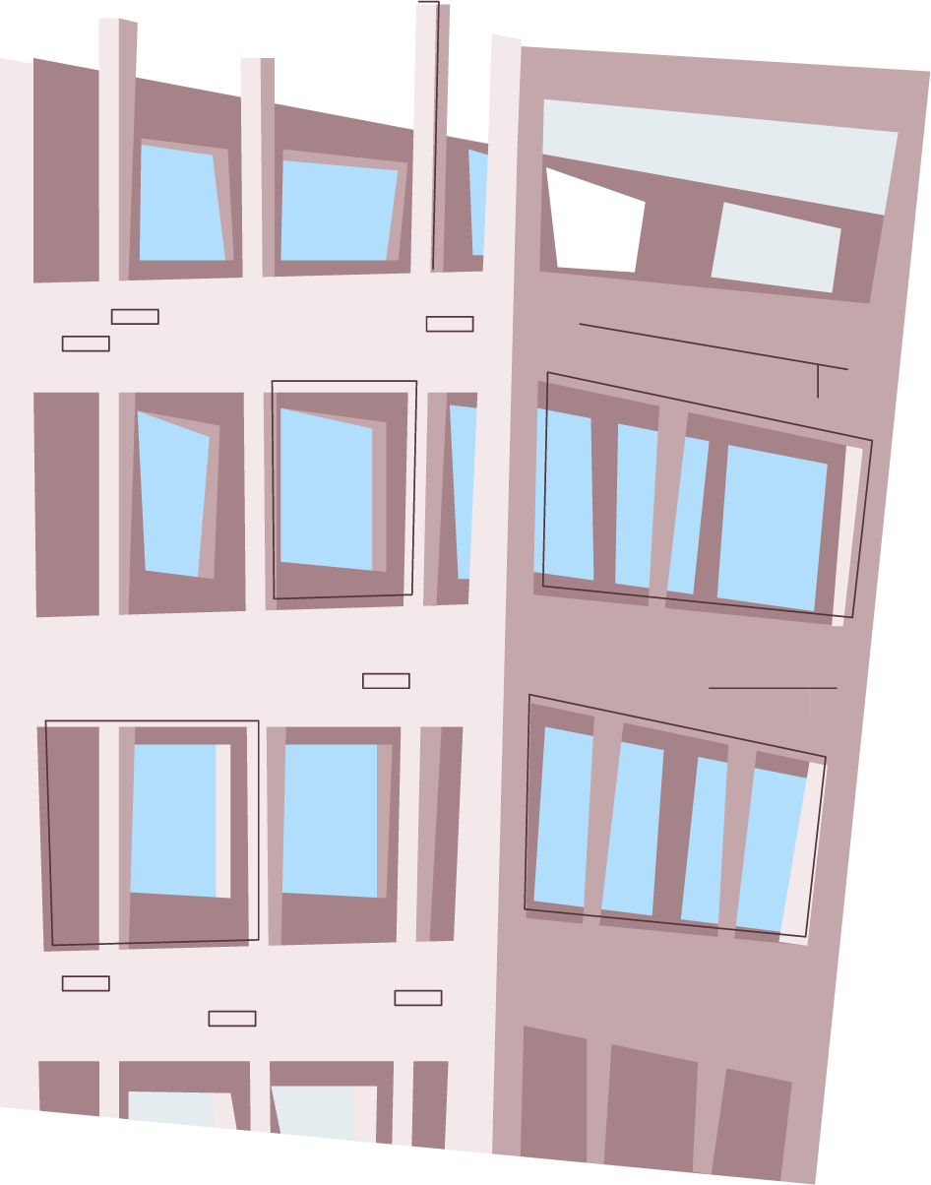
Today’s project: Electrical kit
You will work together to learn about electricity and create a working circuit!

Slide 4
Objectives
01
02
03
04
Perseverance
Committment
Doing your best, even when things are difficult
Being dedicated or loyal to something
Follow-through
Awareness of Careers
Working on something until it is finished
There are all kinds of construction careers, not just building houses and roads!

Slide 5
Materials Needed
Electrical Kit
Batteries
Safety Glasses

Slide 6
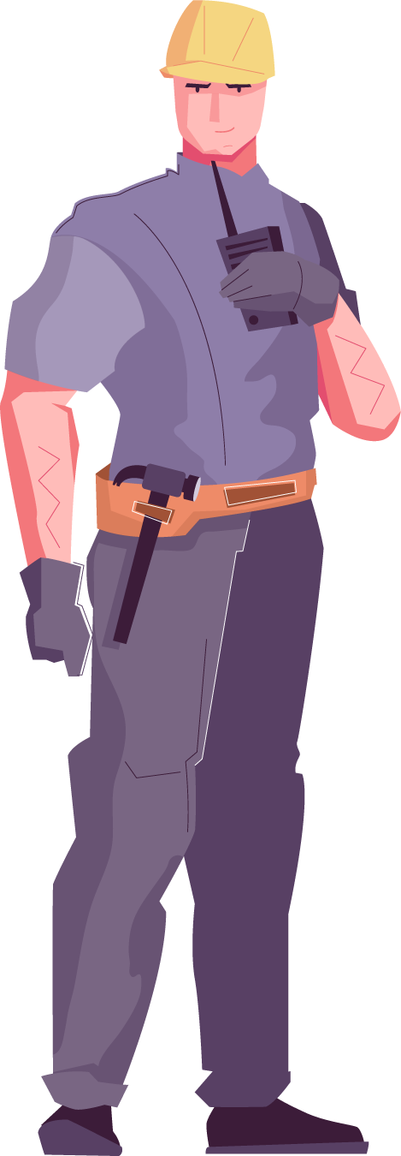
Roles
Project Manager
Laborer
Oversees project
Manages team
Reads Blueprints
Gives directions
Timekeeper
Checks for safety
Uses tools
Monitors area

Slide 7
But first, SAFETY
Safety glasses on when “on-site”
Check your materials
When helping hold materials, be careful of your fingers!
Clean up after yourself

Slide 10
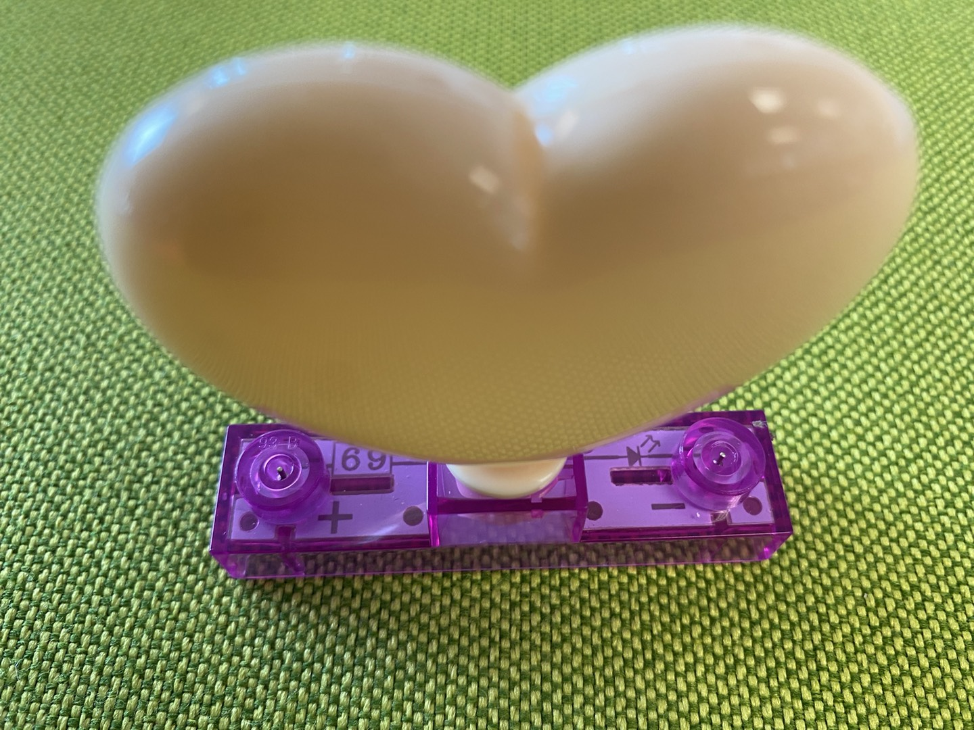
Check your poles!

Slide 11
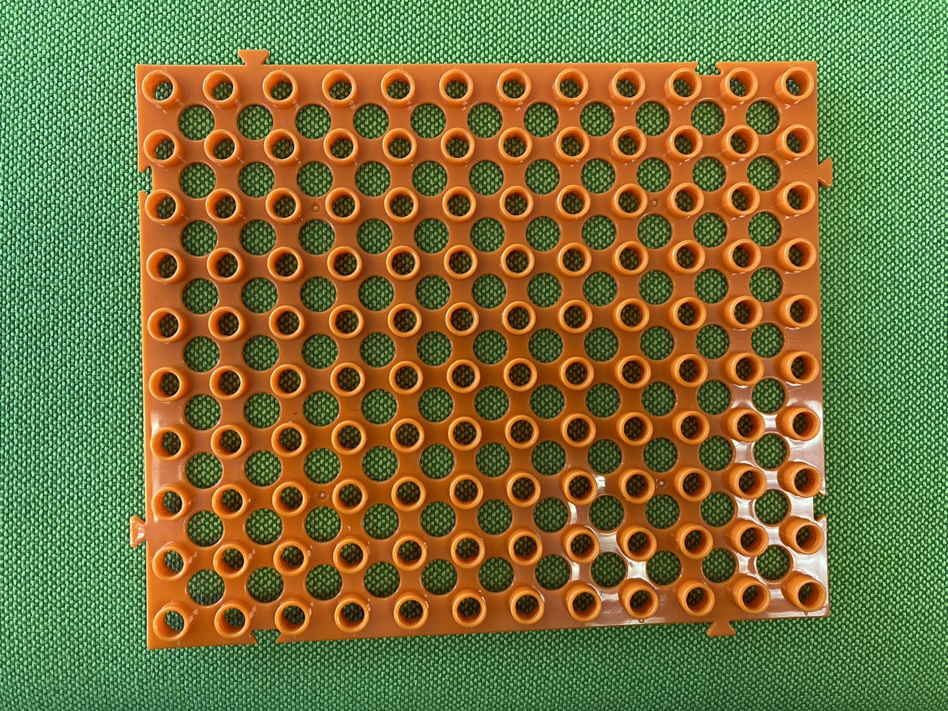
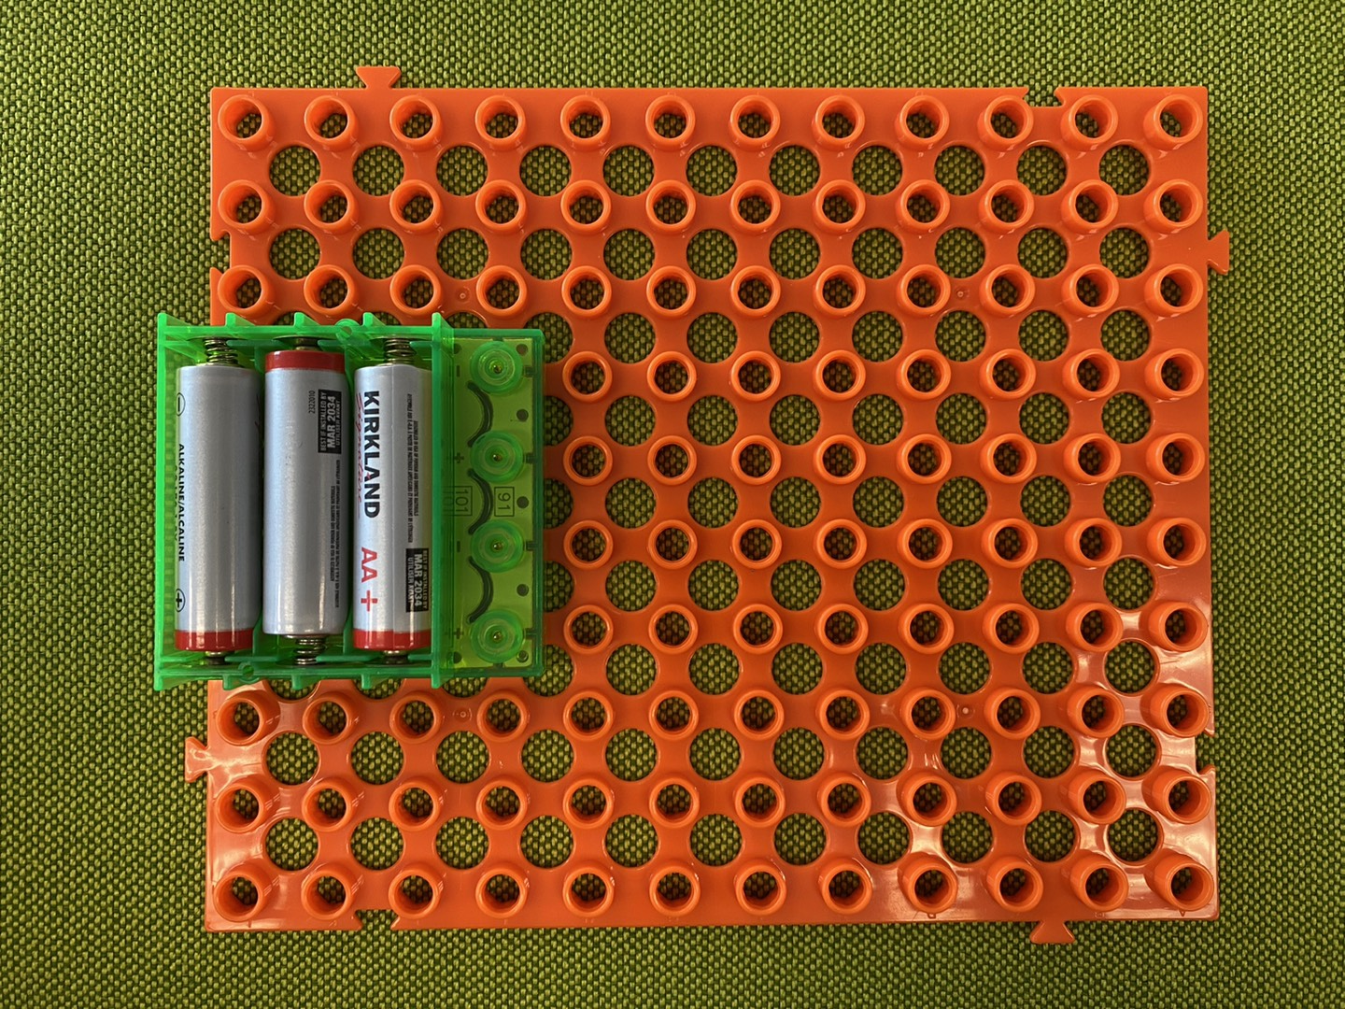
Process
First
Then

Slide 12
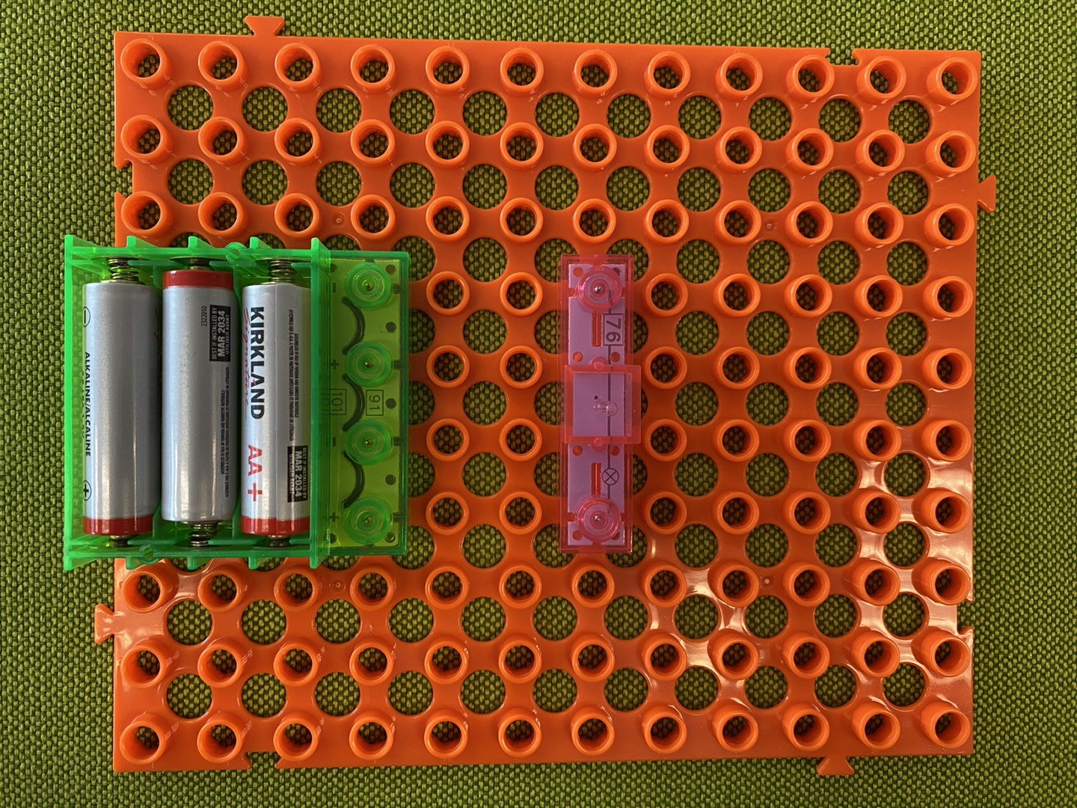
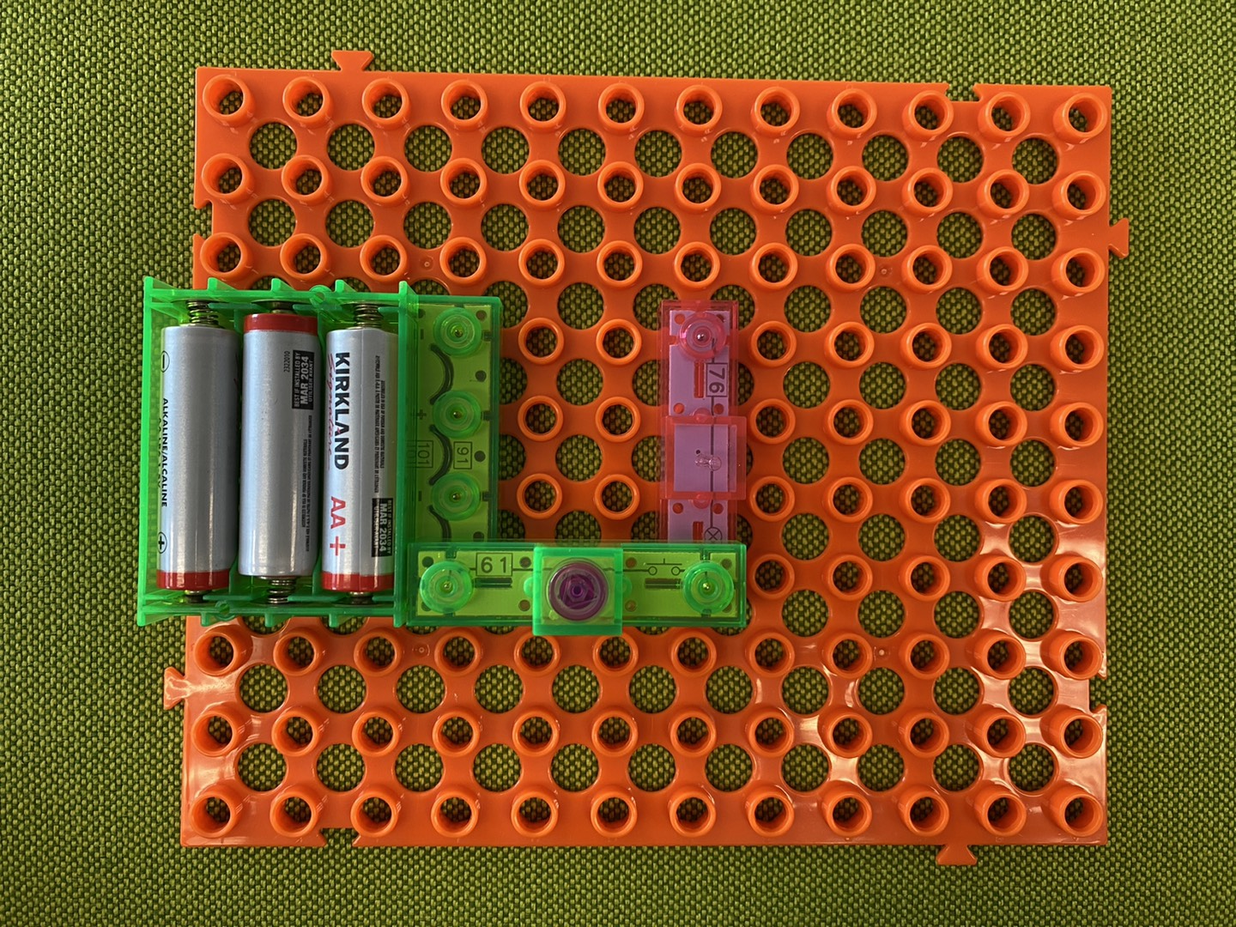
Process
Next
Then

Slide 13
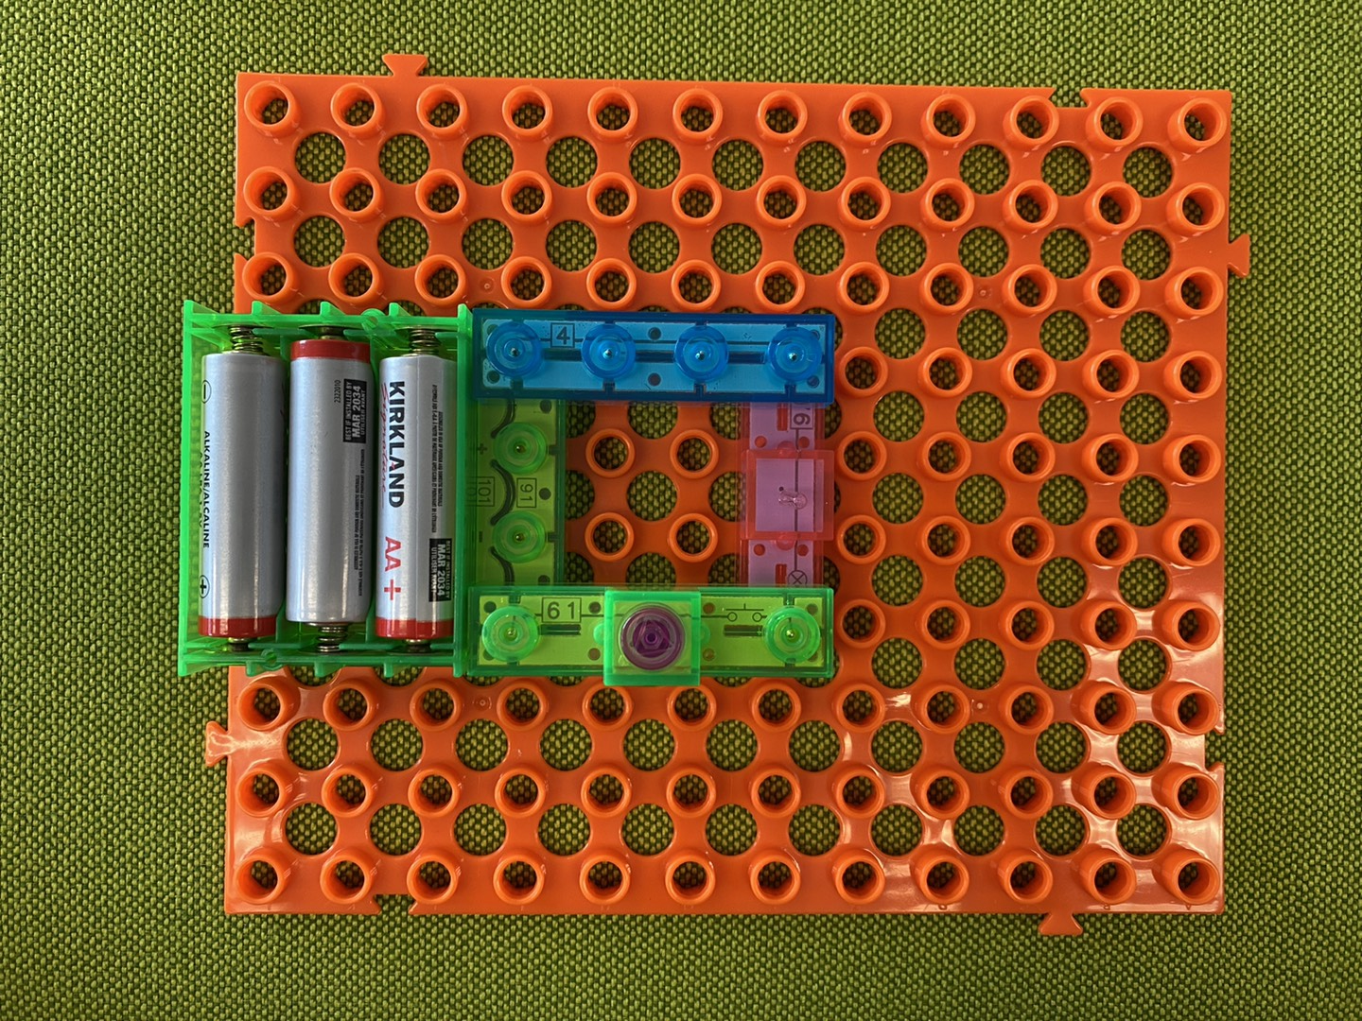
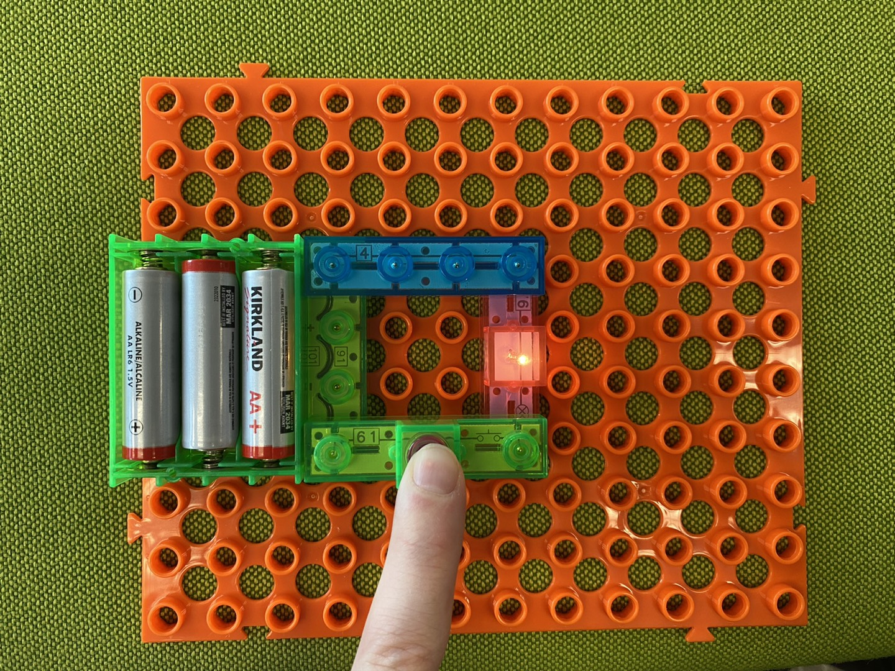
Process
Next
Last

Slide 14
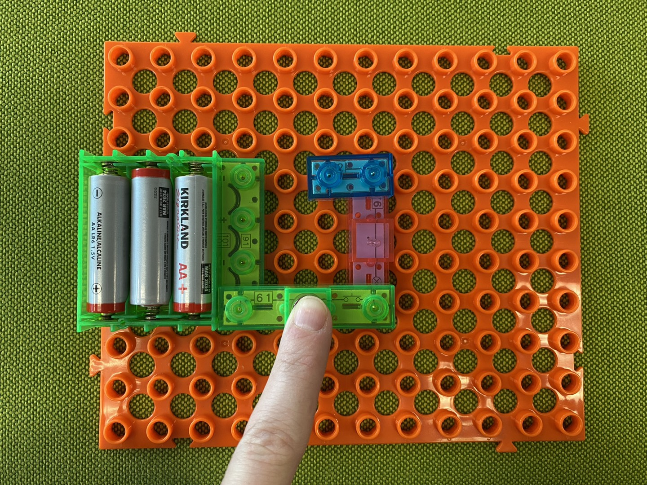
Open vs. Closed Circuit
Open
Closed

Slide 15
JOB EXPLORATION

Slide 17
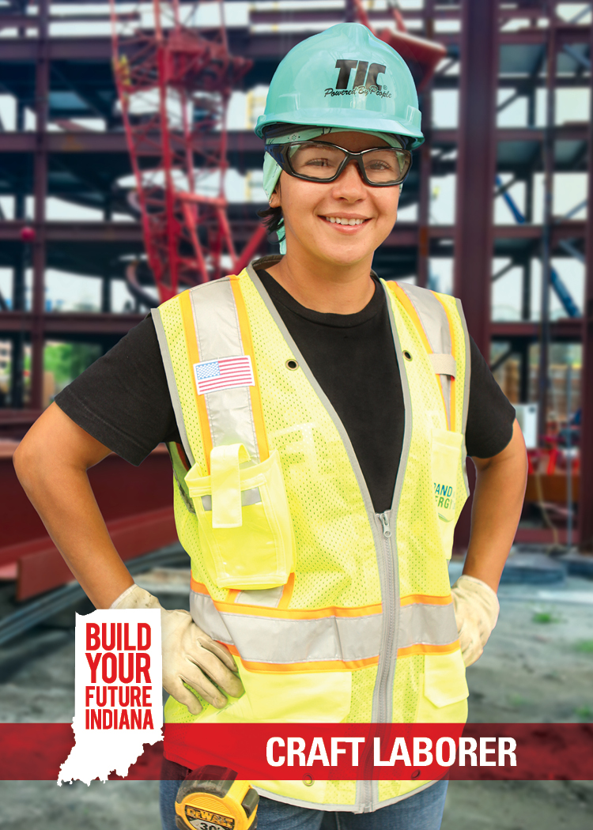
Build It: Craft Laborer
Average Salary: $38,890
Description: Perform basic tasks on a construction site, sometimes at great heights or outdoors in all weather conditions
Education Options: Technical School, Community College, Registered Apprenticeship Program, and Industry Training Program
Qualifications: Manual dexterity, coordination, physical fitness, good sense of balance

Slide 18
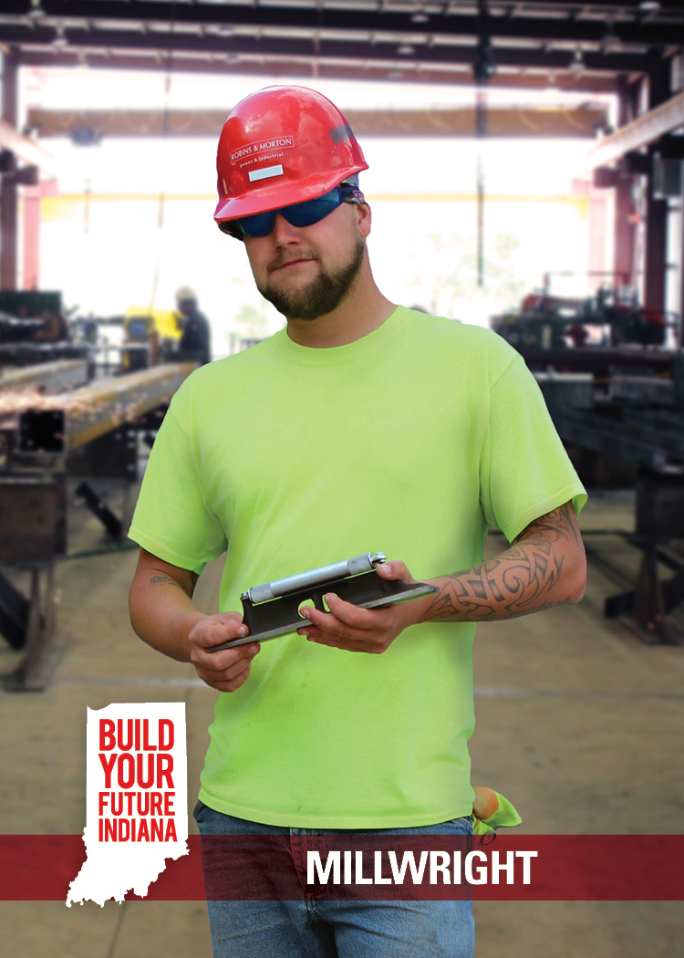
Build It: Millwright
Average Salary: $66,919
Description: Work on construction sites and factories assembling and disassembling machinery. Can involve technical repairs or heavy machining tools.
Education Options: Technical School, Community College, Registered Apprenticeship Program, and Industry Training Program
Qualifications: Good depth perception and manual dexterity, good judgment and decision-making skills
https://youtu.be/g-NBzo1K7UU

Slide 19
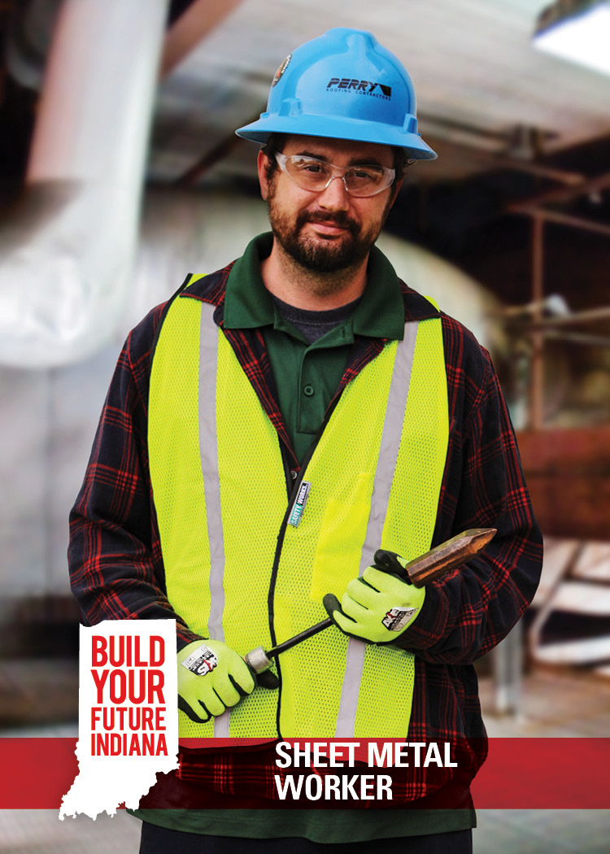
Build It: Sheet Metal Worker
Average Salary: $58,160
Description: Cut and mold sheets of metal into products for installing and repairing ventilation and air ducts; construct airplanes, automobiles, and billboards
Education Options: Technical School, Community College, Registered Apprenticeship Program, and Industry Training Program
Qualifications: Coordination, physical dexterity, mechanical and mathematics aptitude

Slide 20
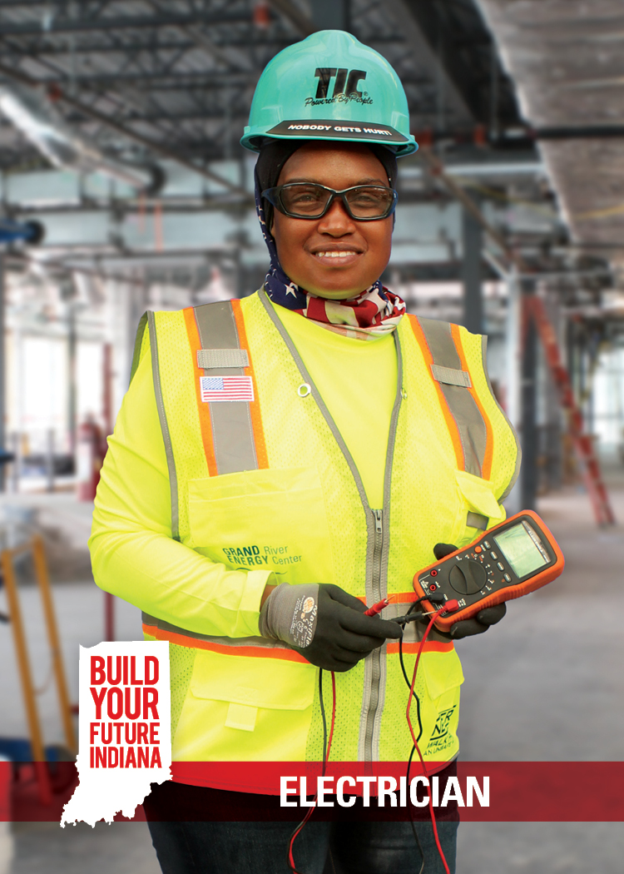
Finish It: Electrician
Average Salary: $67,269
Description: Install and maintain electrical and power systems for homes, business, and factories
Education Options: Technical School, Community College, Registered Apprenticeship Program, and Industry Training Program
Qualifications: Manual dexterity, coordination, physical fitness, good balance, good color vision (to recognize electrical wires)
https://youtu.be/u5ypG1rdwe8
https://youtu.be/AfSISgTo7QQ
https://youtu.be/Akm2O66z8M0

Slide 21
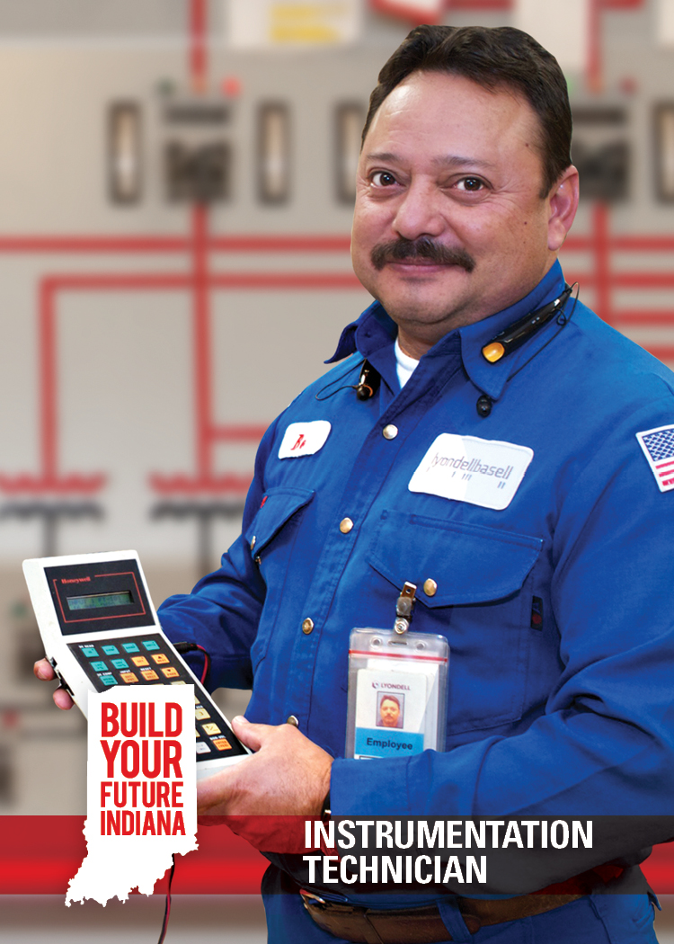
Finish It: Instrumentation Technician
Average Salary: $70,080
Description: Perform key installation and maintenance functions across industries and are trained in piping, tubing, fasteners, and working with metal production
Education Options: Technical School, Community College, Registered Apprenticeship Program, and Industry Training Program
Qualifications: Manual dexterity, coordination, physical fitness, good sense of balance, problem solving

Slide 22
Wrap Up
How much fun did you have today?
Google form:
https://forms.gle/yRE97YhMAXxbL6fY6

