Slide 1
BYF
CONSTRUCTION CLUB
Session 6

Slide 2
Greeting
Huckle Buckle Beanstalk
Everyone puts their head down and closes their eyes.
One person hides an item in the room.
*The item must be hidden where it can be seen without moving anything*
When the hider says, “Go!” everyone can get up to look for the item.
When someone finds an item, they quietly sneak back to their seat, sit down, and say “Huckle Buckle Beanstalk!”
Once half the people have found the item, they can give “hot” and cold” clues.
The person who found the item first gets to hide it the next round.

Slide 3
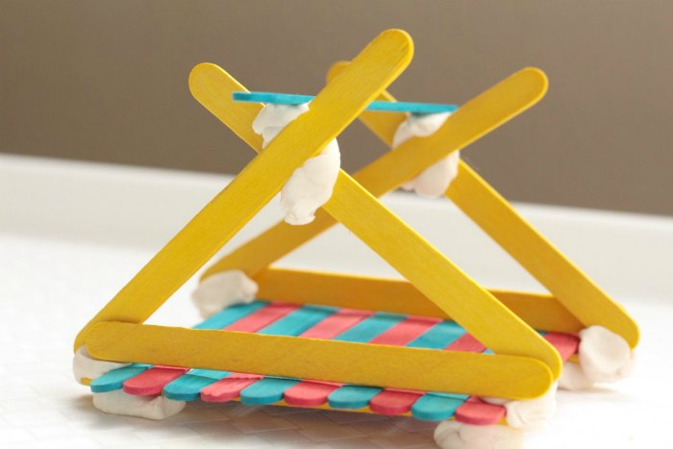
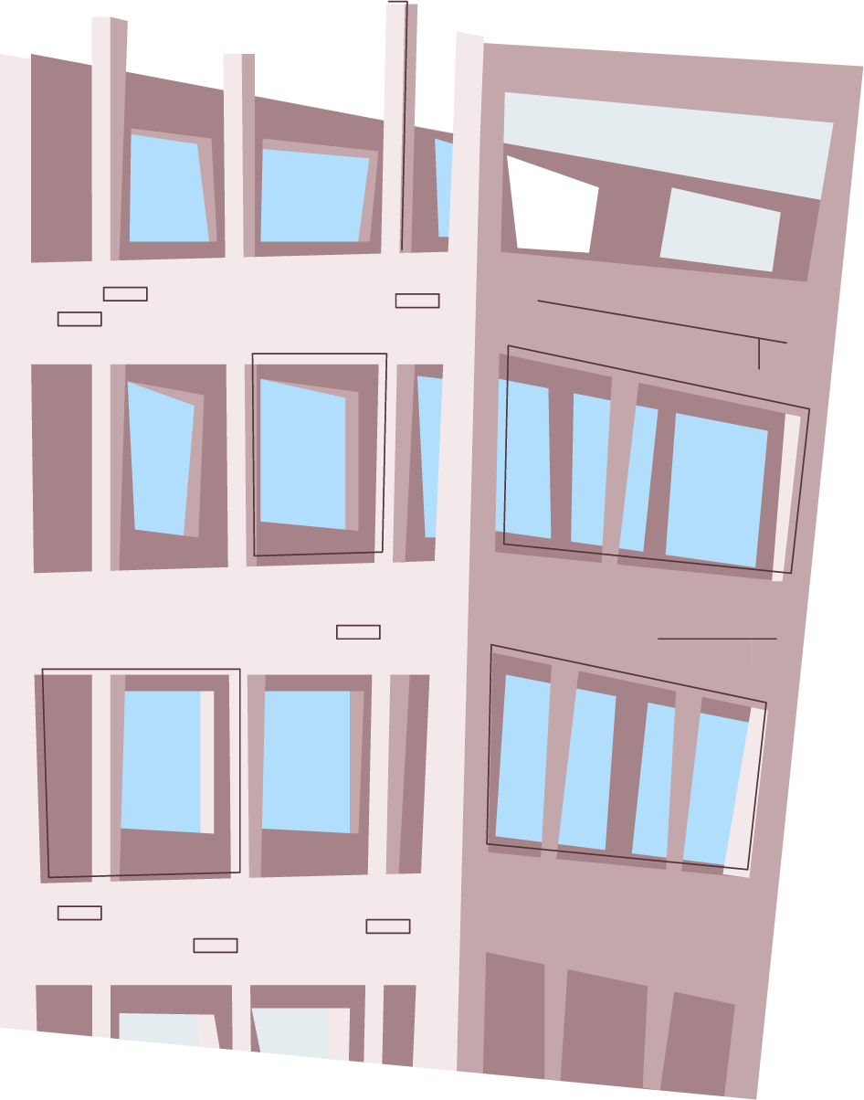
Today’s project: Craft Stick Structures
You will work with your group to create a structure out of popsicle sticks and playdoh!

Slide 4
Materials Needed
Craft sticks
Playdoh
Safety glasses

Slide 5
WATCH
https://youtu.be/oVOnRPefcno
https://youtu.be/el1K-xILtwo

Slide 6
Objectives
01
02
03
04
Problem Solving
Critical Thinking
Working through problems until they are solved
Evaluating solutions and choosing the best one
Structural Integrity
Engineering
How much weight structures can hold
Solving problems in new and creative ways

Slide 7
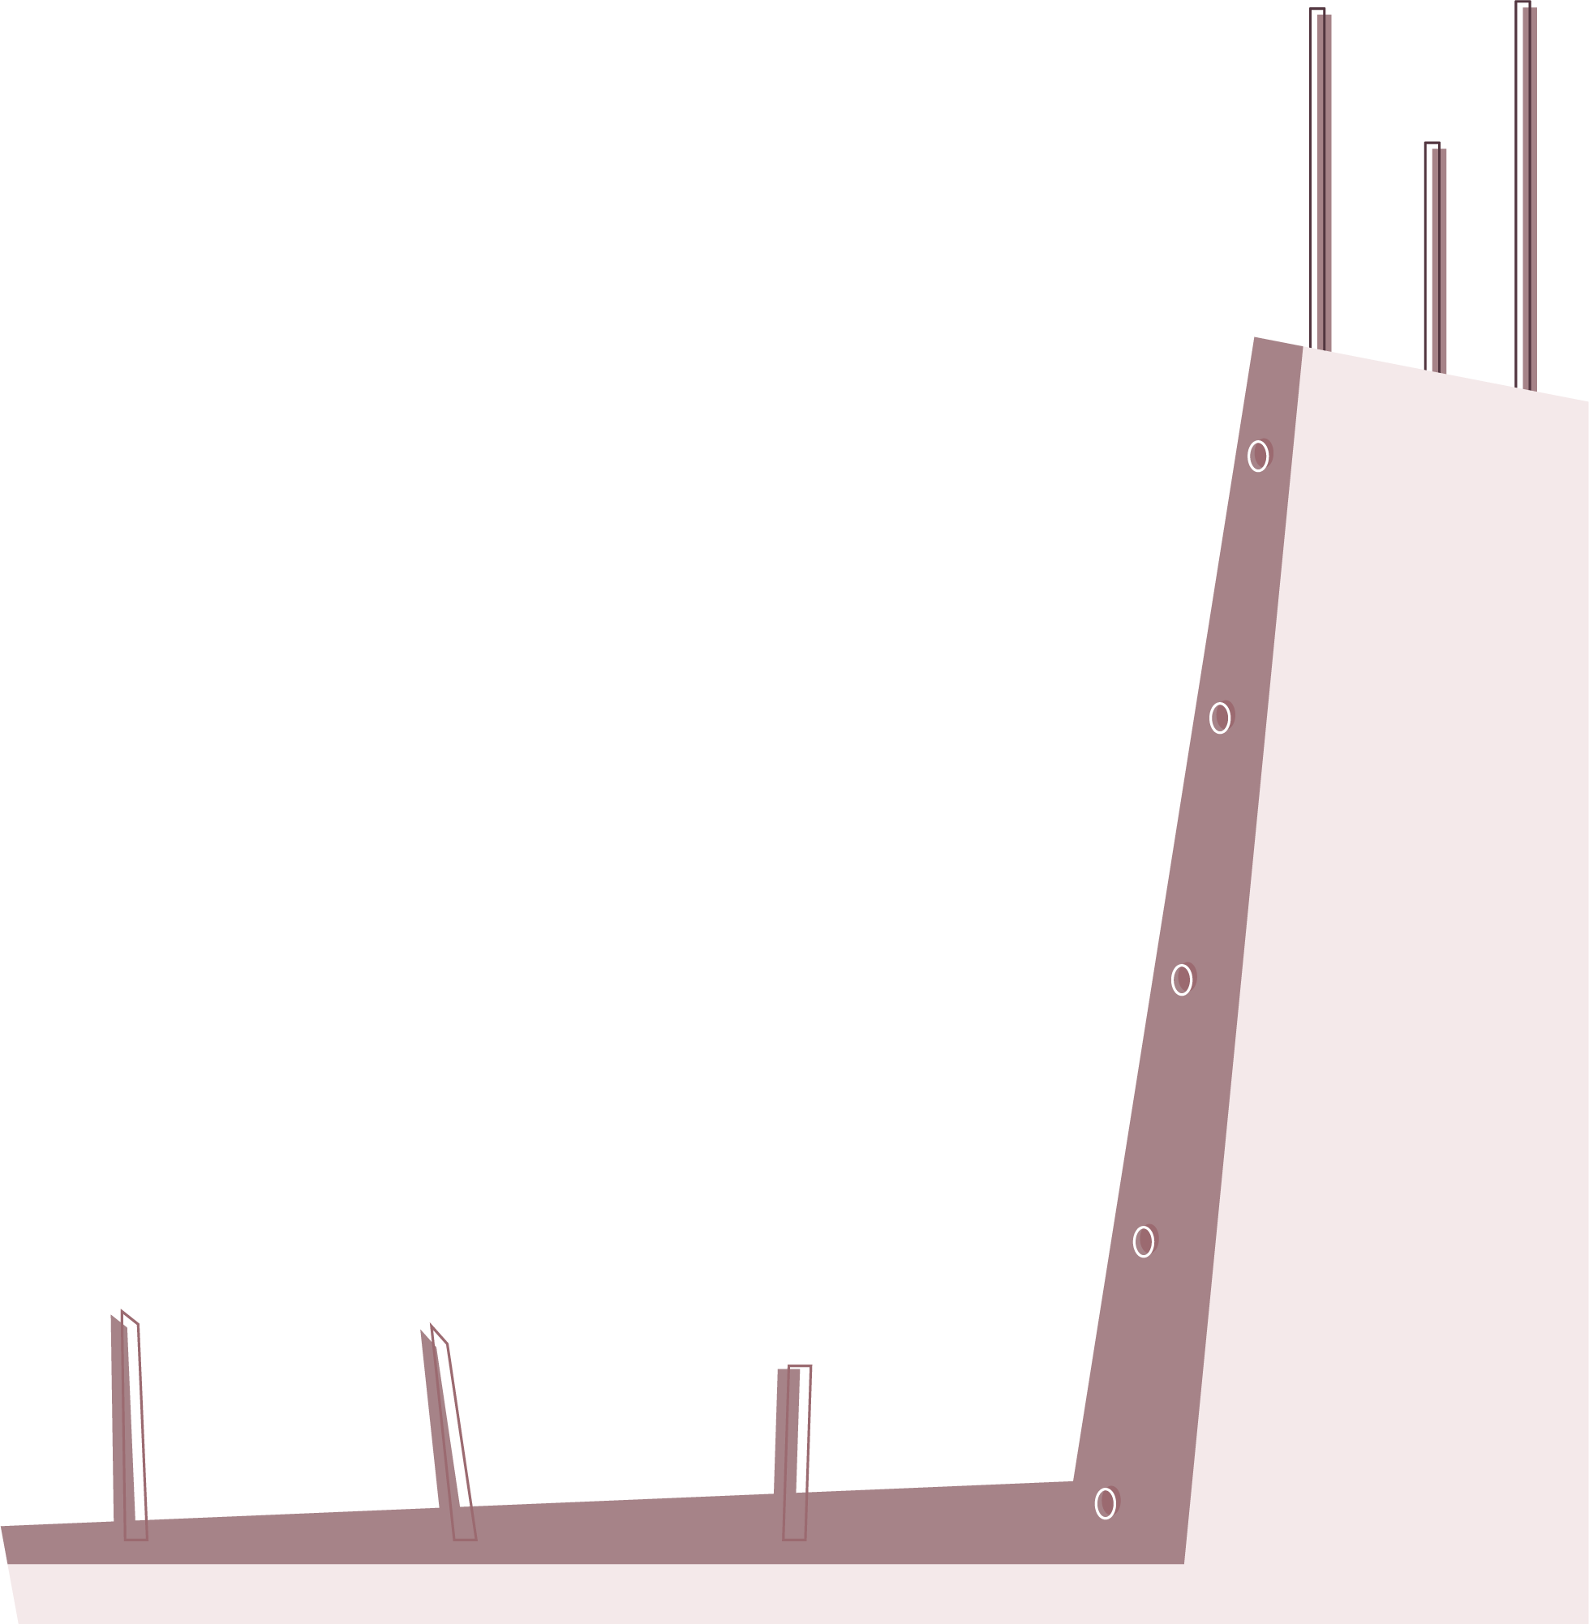
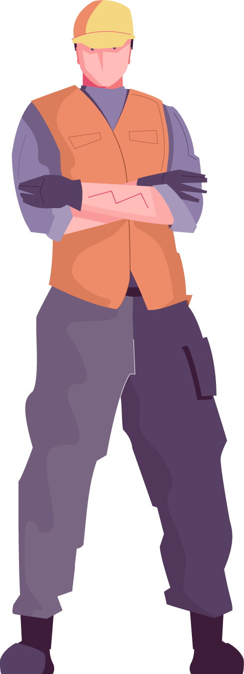
But first, SAFETY
Safety glasses on when “on-site”
Be careful
Stay in your area
Clean up after yourself

Slide 8
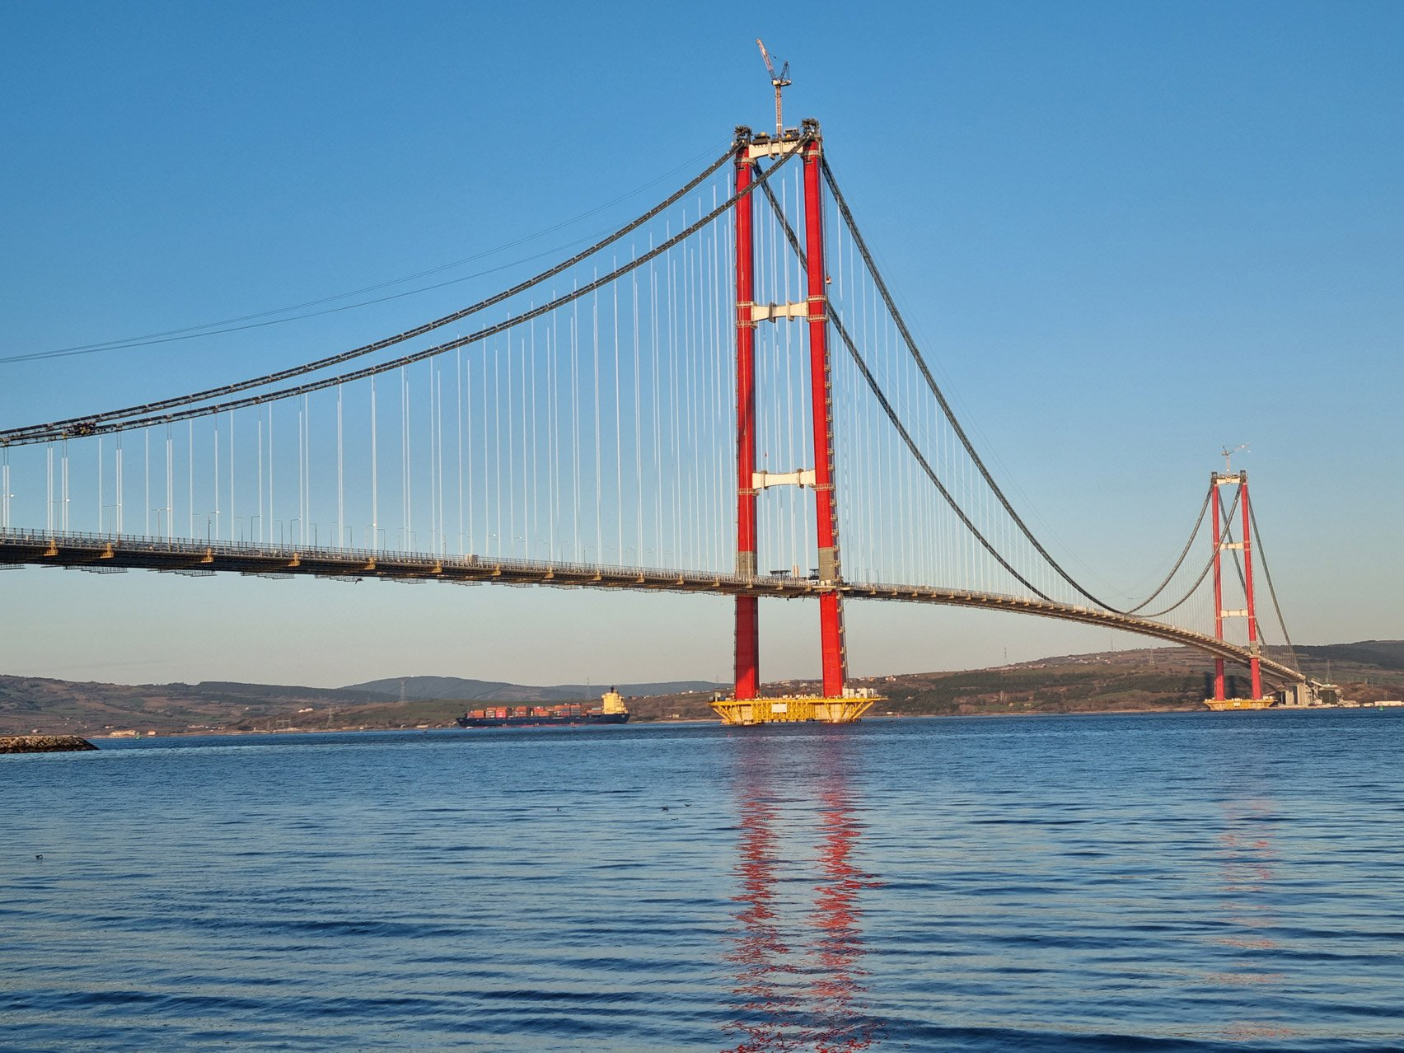
Challenge #1
Bridge
Goal:
Using the materials given, build a bridge that can hold our pullback cars from Session 5!

Slide 9
Challenge #1
Examples:

Slide 10
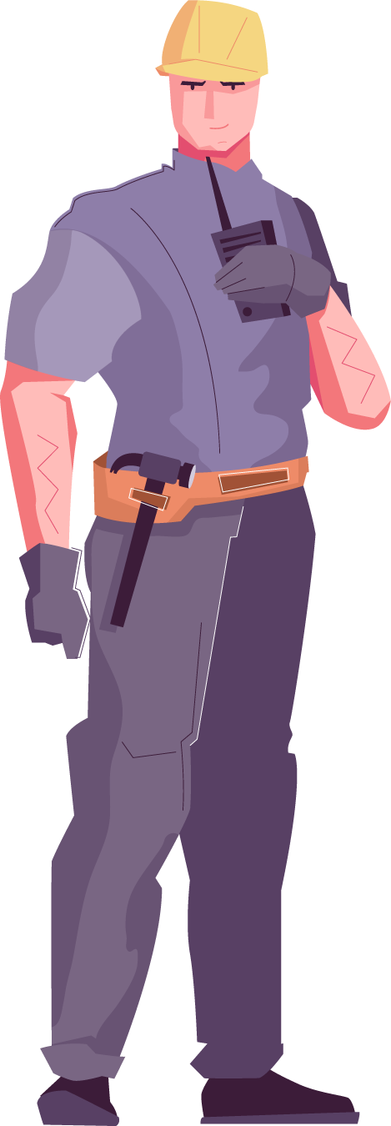
Bridge Challenge Reflection
What did other groups do that was the same as your bridge?
What did other groups do that was different than your bridge?
What are the advantages and disadvantages of your bridge?

Slide 11
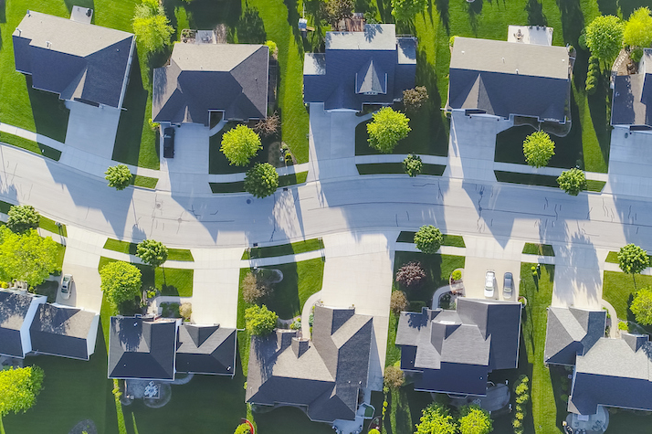
Challenge #2
Neighborhood
Goal:
Using the materials given, build a house that would go in a neighborhood!

Slide 12
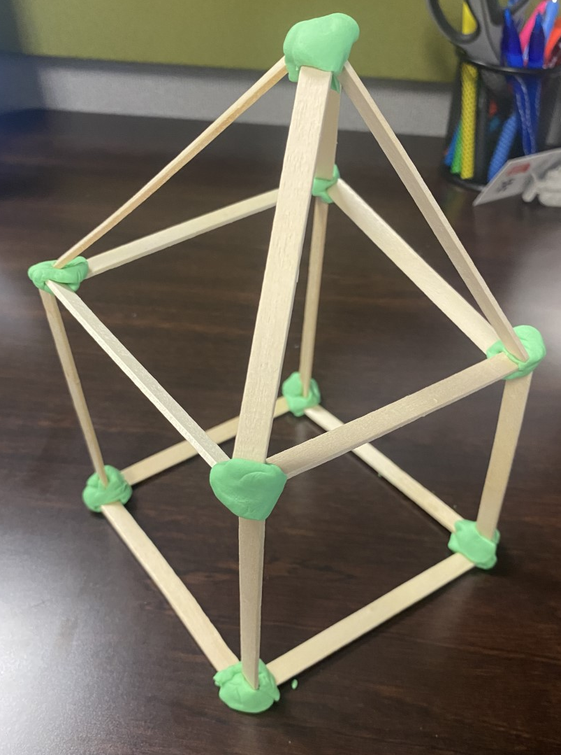
Challenge #2
Example:

Slide 13
Neighborhood Challenge Reflection
What did other groups do that was the same as your house?
What did other groups do that was different than your house?
What are the advantages and disadvantages of your house?

Slide 14
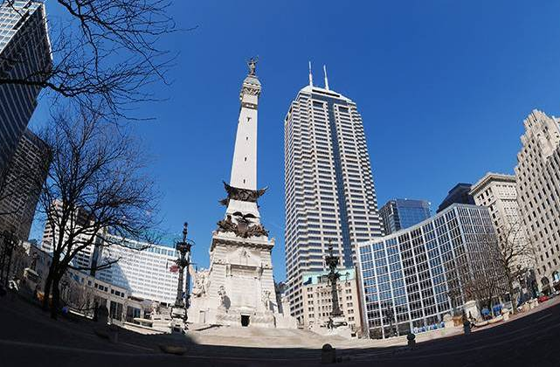
Challenge #3
Tower
Goal:
Using the materials given, build a tower with at least 3 floors!

Slide 15
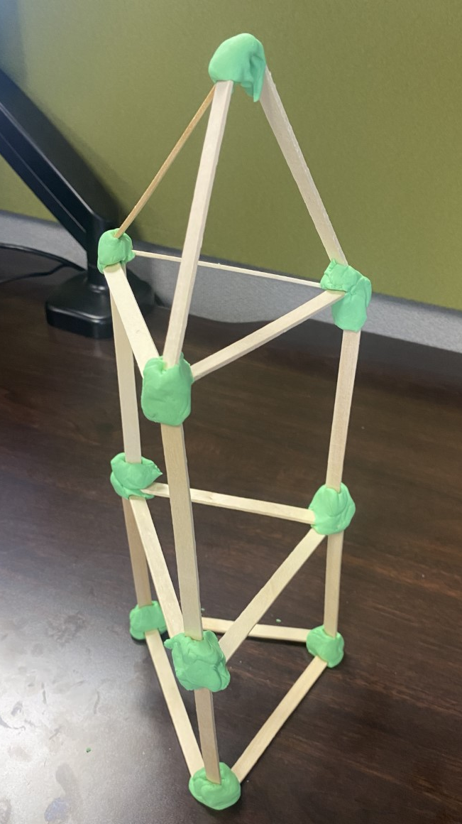
Challenge #3
Example:

Slide 16
Tower Challenge Reflection
What did other groups do that was the same as your tower?
What did other groups do that was different than your tower?
What are the advantages and disadvantages of your tower?

Slide 17
FINAL Craft Stick Challenge Choose 1:
Bridge
Building
Neighborhood
Build the LONGEST bridge
Build the TALLEST structure
Build the MOST houses

Slide 18
JOB EXPLORATION

Slide 19
Construction Careers
Commercial, Residential, or Civil?
What build today was commercial construction?
What build today was residential construction?
What build today was civil construction?

Slide 21
Plan It: Business Developer
Average Salary: $45,000 to $85,000 to $300,000+
Description: Create and maintain relationships and seek out new business opportunities. The face of the construction-related company with an end goal to lead to more business
Education Options: Bachelor’s degree is business, sometimes an MBA
Qualifications: Creative, persuasive, problem solving, spot trends and patterns, ability to perform under pressure, personable

Slide 22
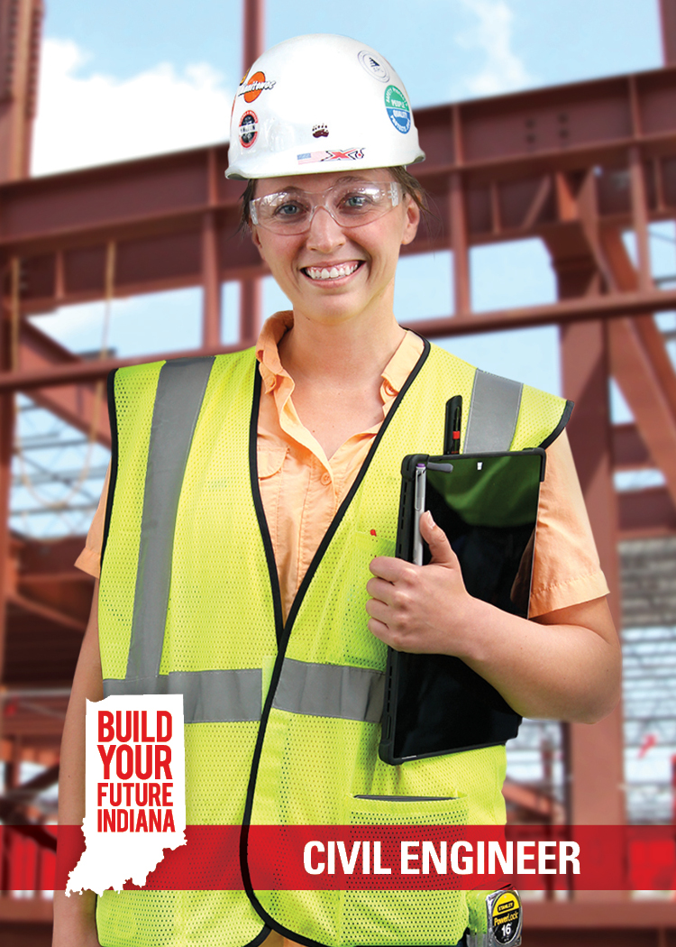
Plan It: Civil Engineer
Average Salary: $91,790
Description: Design, construct, supervise, operate, and maintain large construction projects and systems including roads, buildings, airports, tunnels, dams, bridges, and systems for water supply and sewage treatment
Education Options: Bachelor’s degree, Master’s degree, and Project Management Certification
Qualifications: Problem solving, critical thinking, creativity

Slide 23
Plan It: Architect
Average Salary: $45,000 to $75,000 to $120,000+
Description: Listen to client needs and desires and prepare drawings/specifications for final product. Responsible for final design and budget as well as the engineering and math needed
Education Options: Bachelor’s degree
Qualifications: Creative, problem solving, good with technology, enjoys research and working with others, enjoys math, communication

Slide 24
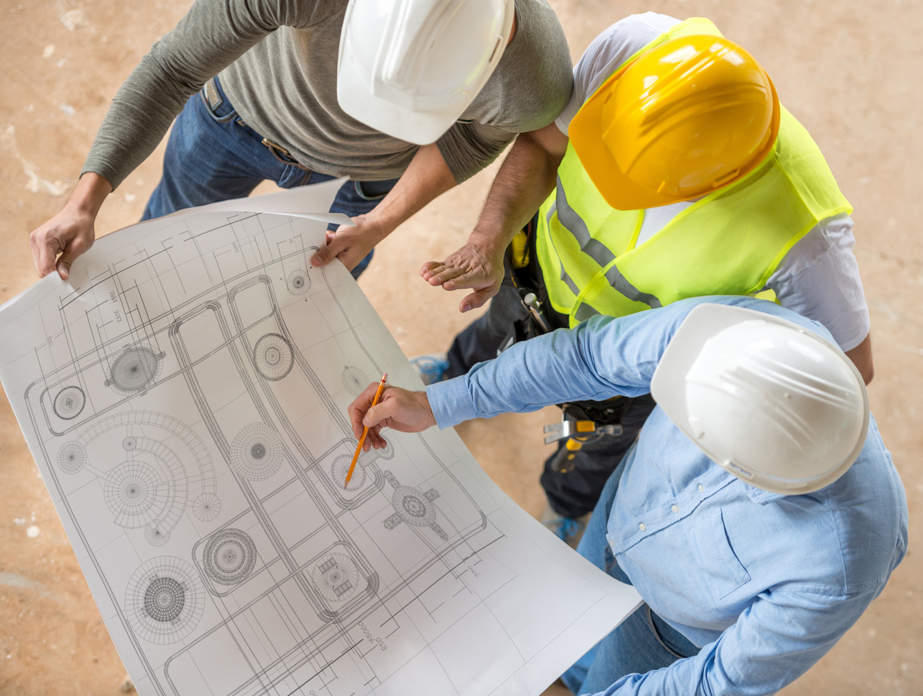
Build It: Structural Engineer
Average Salary: 60,000 to $78,000 to $120,000+
Description: Take the design from the architect and decide the best materials to use based on location and weather. Make sure the “bones” are appropriate for the environment and will keep standing.
Education Options: Bachelor’s degree
Qualifications: Creative, problem solving, ability to find trends and patterns, research
https://youtu.be/BQzERXpnP00

Slide 25
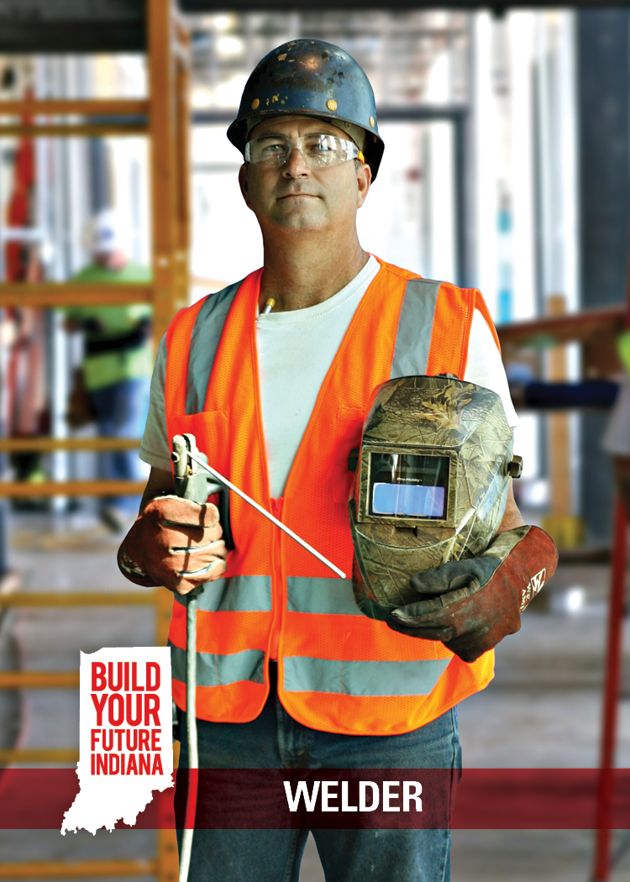
Build It: Welder
Average Salary: $71,067
Description: Join objects together by applying heat or pressure; knowledge of welding principals and metals; use blueprints and drawings to build
Education Options: Technical School, Community College, Registered Apprenticeship Program, and Industry Training Program
Qualifications: Attention to detail, manual dexterity, coordination, ability to read blueprints and drawings
https://youtu.be/BQzERXpnP00

Slide 26
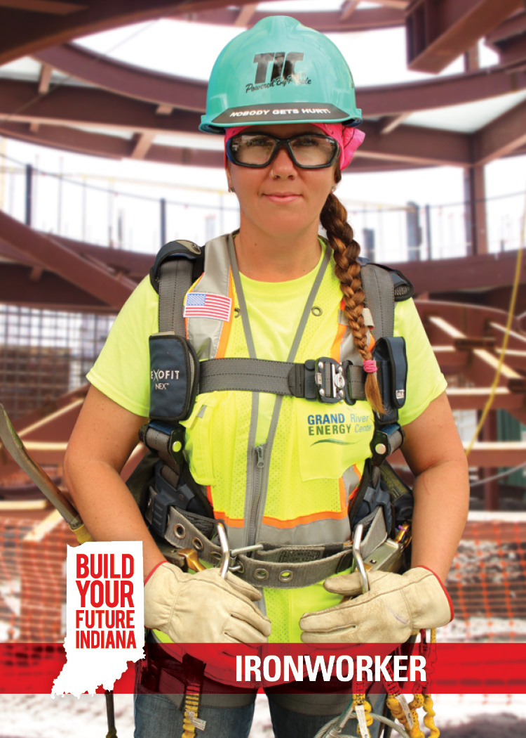
Build It: Ironworker
Average Salary: $60,060
Description: Place and install iron or steel girders, columns, and other construction materials to form structures
Education Options: Technical School, Community College, Registered Apprenticeship Program, and Industry Training Program
Qualifications: Attention to detail, physical dexterity, coordination, good balance and agility, mechanical and mathematic aptitude
https://youtu.be/ELeycZxidWY

Slide 27
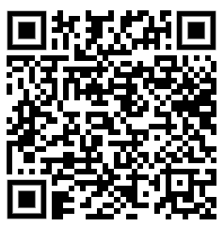
Wrap Up
How much fun did you have today?
How much fun was the club overall?
What was your favorite project?
Would you do construction club again?
What would make construction club better?
Google form:
https://forms.gle/as4Eq5pJfu1kpwTR9

