Slide 1
BYF
CONSTRUCTION CLUB
Session 5

Slide 2
Greeting
Clump
Students will form groups or “clumps” based on the leader’s instructions.
Example: groups of 3!
Anyone not in a “clump” is out.
When two students are left, play Hammer/Blueprint/Architect to determine winner.

Slide 3
Today’s project: Pull back car
You will work together to use a hammer and nails to make a pull back car. Then, your group will be able to paint and decorate it. Last, you will be able to test out your cars!

Slide 4
Objectives
01
02
03
04
Perseverance
Committment
Doing your best, even when things are difficult
Being dedicated or loyal to something
Follow-through
Awareness of Careers
Working on something until it is finished
There are all kinds of construction careers, not just building houses and roads!

Slide 5
Materials Needed
Hammer
Blueprints
Car Kit (Wood, nails, wheel mechanism, stickers)
Paint
Paper plate
Paint brushes
Cup and water
Paper towel
Safety glasses

Slide 6
Roles
Project Manager
Laborer
Oversees project
Manages team
Reads Blueprints
Gives directions
Timekeeper
Checks for safety
Uses tools
Monitors area

Slide 7
But first, SAFETY
Safety glasses on when “on-site”
Check your materials
When helping hold materials, be careful of your fingers!
Clean up after yourself

Slide 8
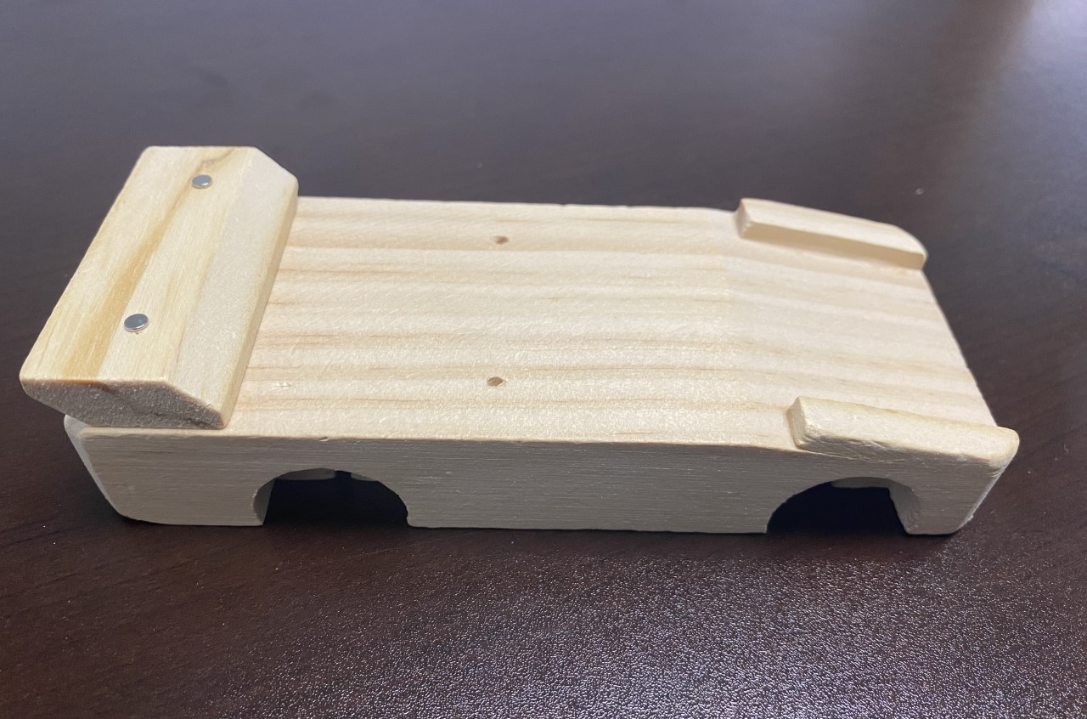
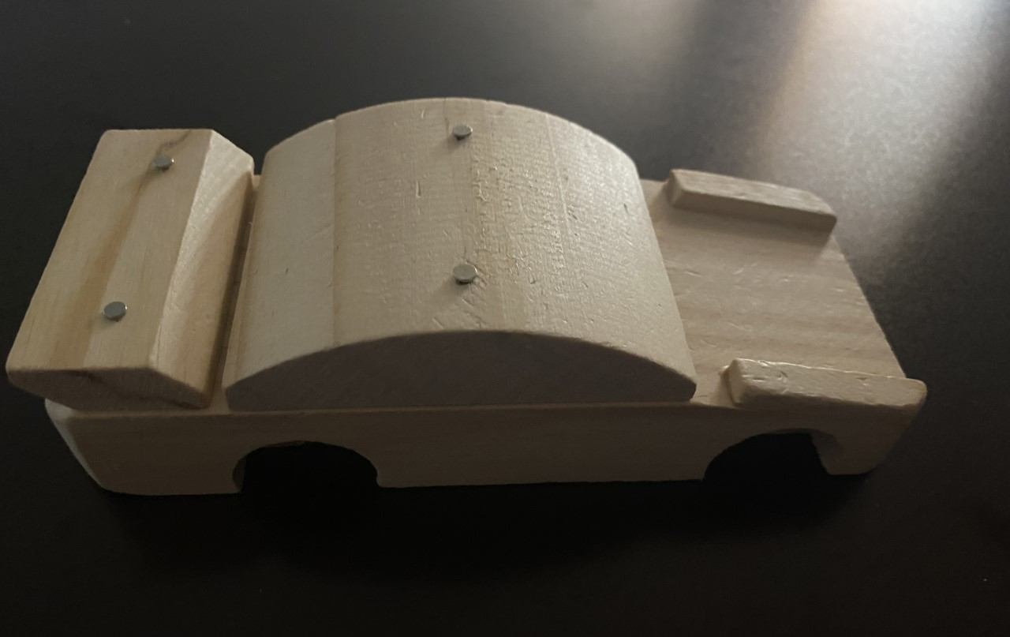
Process
First
Then

Slide 9
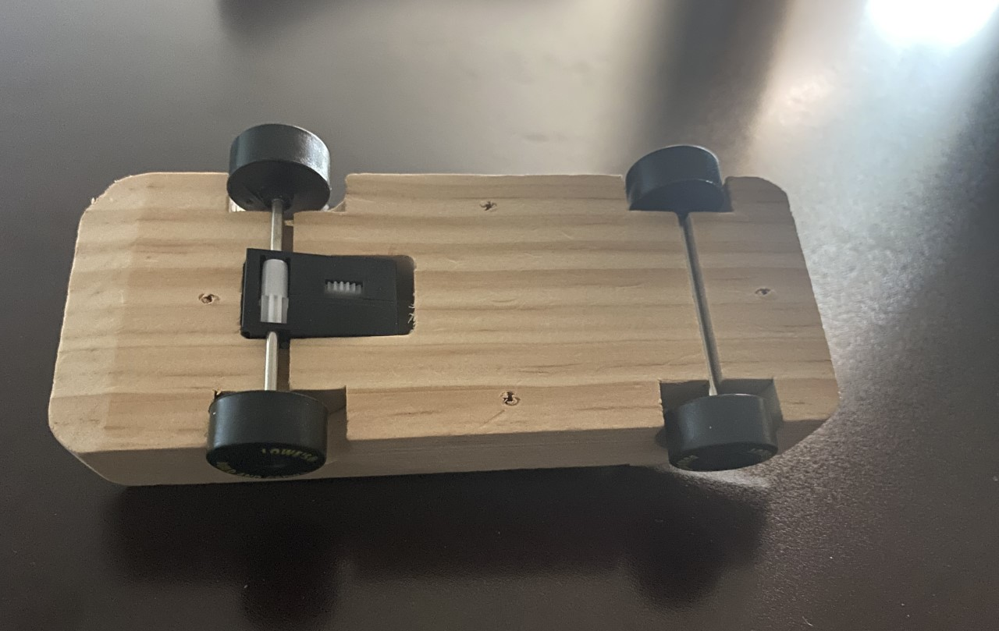
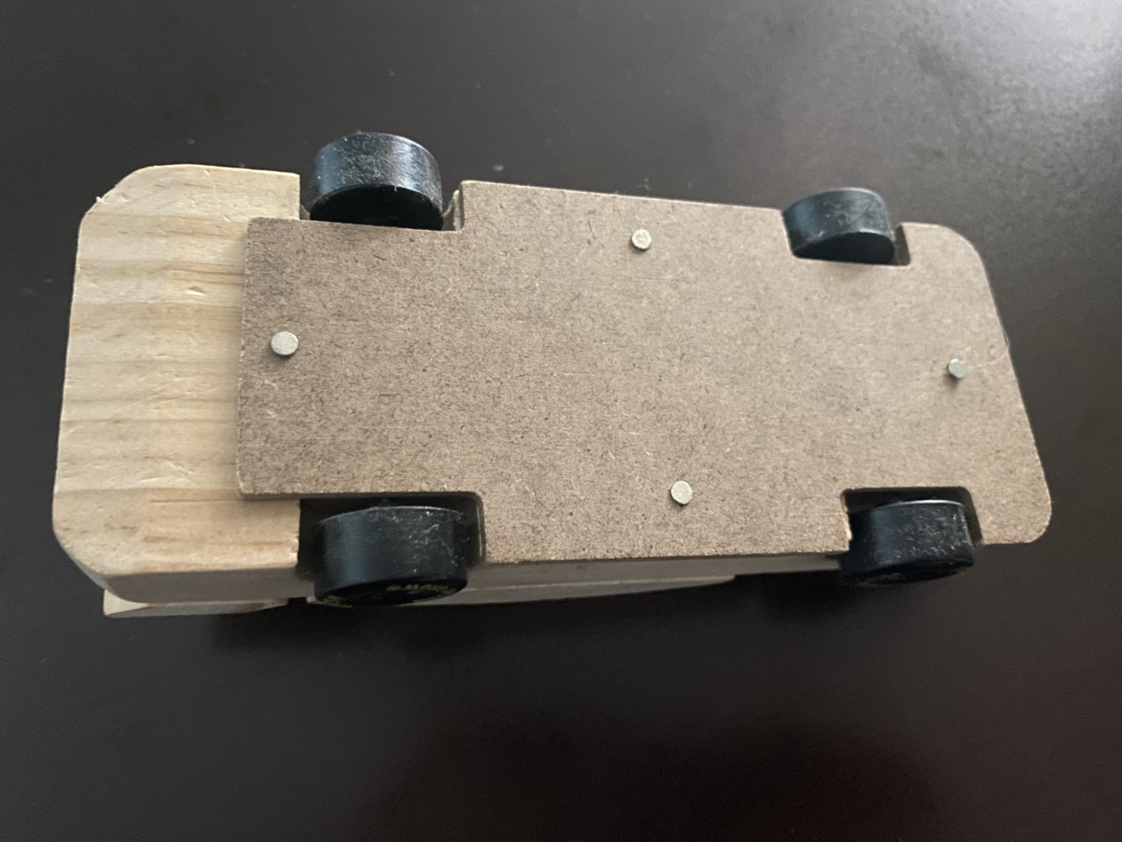
Process
Next
Then

Slide 10
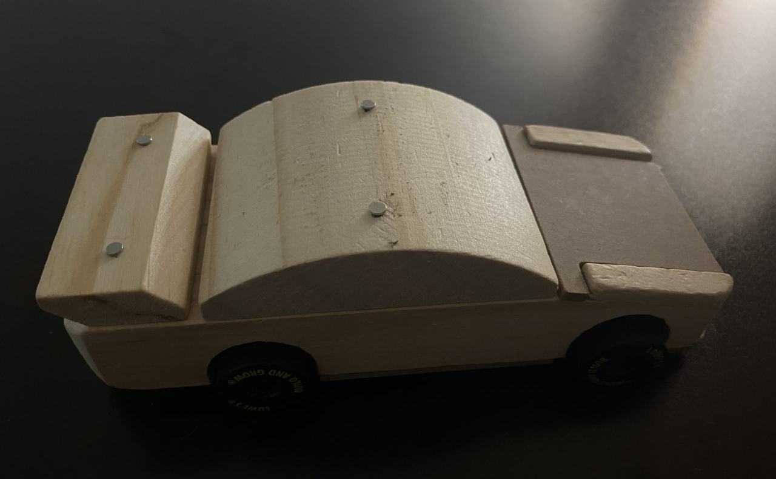
Process
Next
Last

Slide 11
JOB EXPLORATION

Slide 13
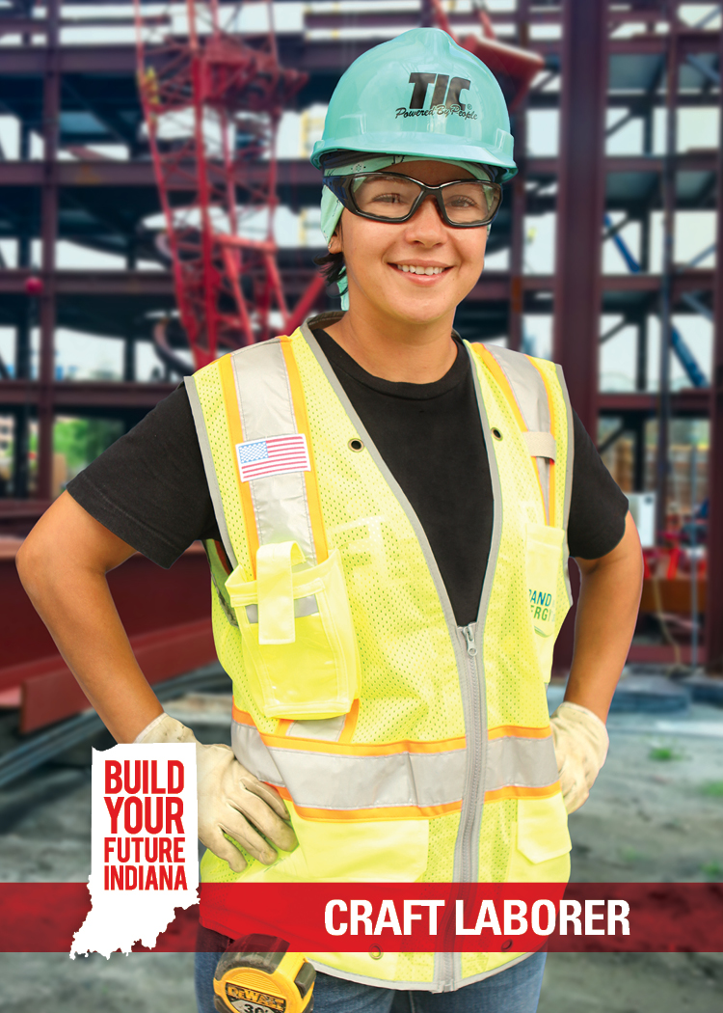
Build It: Craft Laborer
Average Salary: $38,890
Description: Perform basic tasks on a construction site, sometimes at great heights or outdoors in all weather conditions
Education Options: Technical School, Community College, Registered Apprenticeship Program, and Industry Training Program
Qualifications: Manual dexterity, coordination, physical fitness, good sense of balance

Slide 14
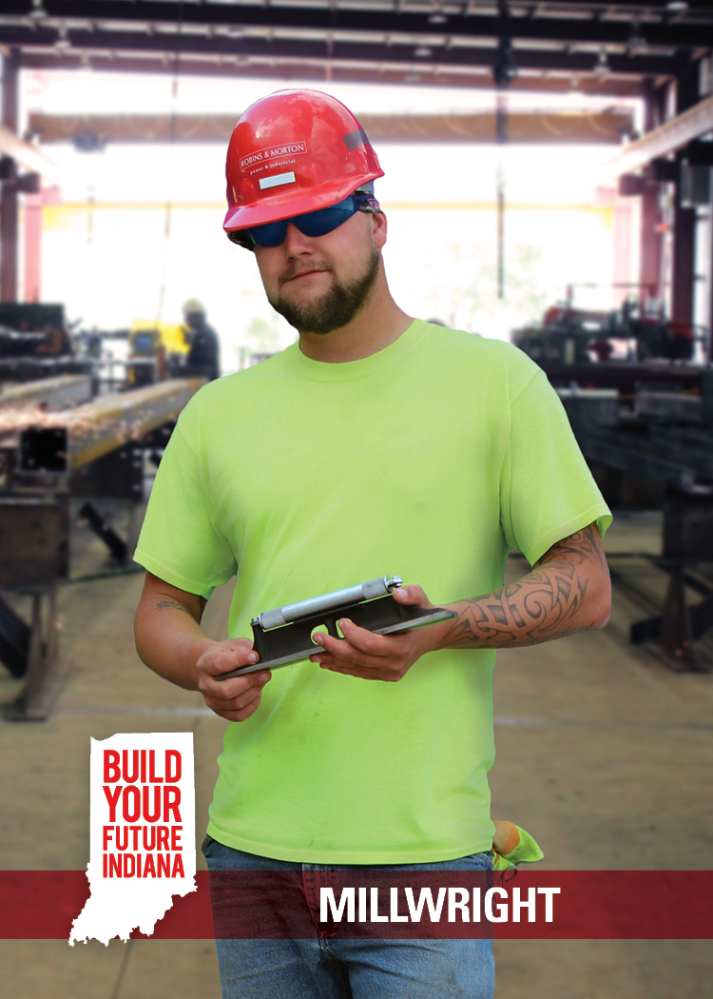
Build It: Millwright
Average Salary: $66,919
Description: Work on construction sites and factories assembling and disassembling machinery. Can involve technical repairs or heavy machining tools.
Education Options: Technical School, Community College, Registered Apprenticeship Program, and Industry Training Program
Qualifications: Good depth perception and manual dexterity, good judgment and decision-making skills
https://youtu.be/g-NBzo1K7UU

Slide 15
Build It: Sheet Metal Worker
Average Salary: $58,160
Description: Cut and mold sheets of metal into products for installing and repairing ventilation and air ducts; construct airplanes, automobiles, and billboards
Education Options: Technical School, Community College, Registered Apprenticeship Program, and Industry Training Program
Qualifications: Coordination, physical dexterity, mechanical and mathematics aptitude

Slide 16
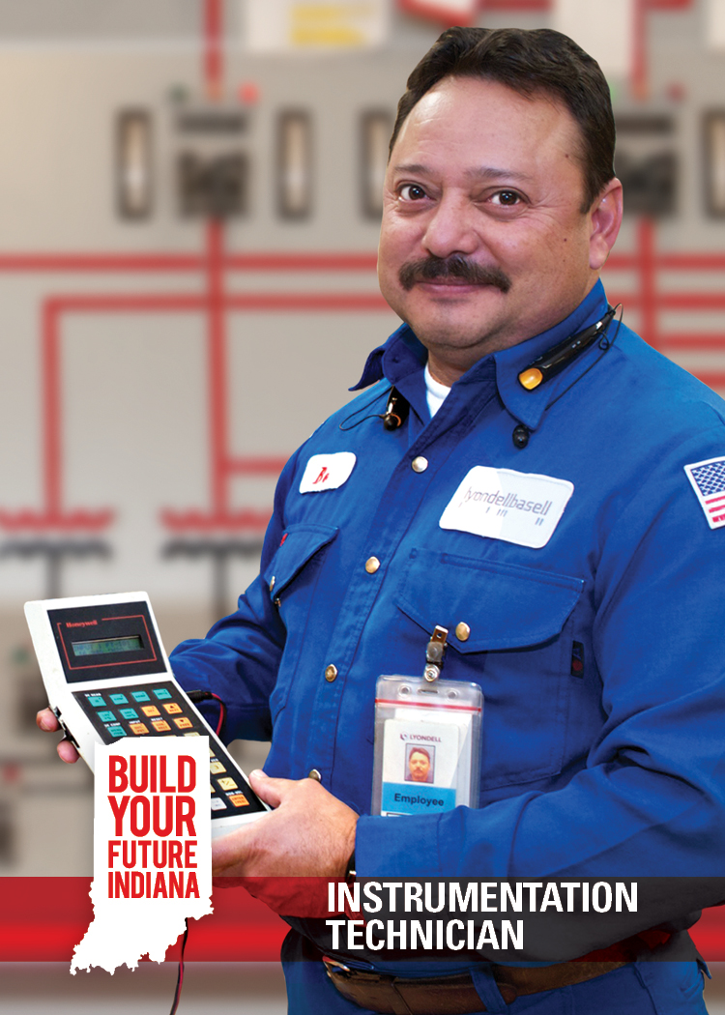
Finish It: Instrumentation Technician
Average Salary: $70,080
Description: Perform key installation and maintenance functions across industries and are trained in piping, tubing, fasteners, and working with metal production
Education Options: Technical School, Community College, Registered Apprenticeship Program, and Industry Training Program
Qualifications: Manual dexterity, coordination, physical fitness, good sense of balance, problem solving

Slide 17
Wrap Up
How much fun did you have today?
Google form:
https://forms.gle/yRE97YhMAXxbL6fY6

