Slide 1


BYF
CONSTRUCTION CLUB
Session 4

Slide 2


Today’s project:
Job Site Visit
Today you will…

Slide 3
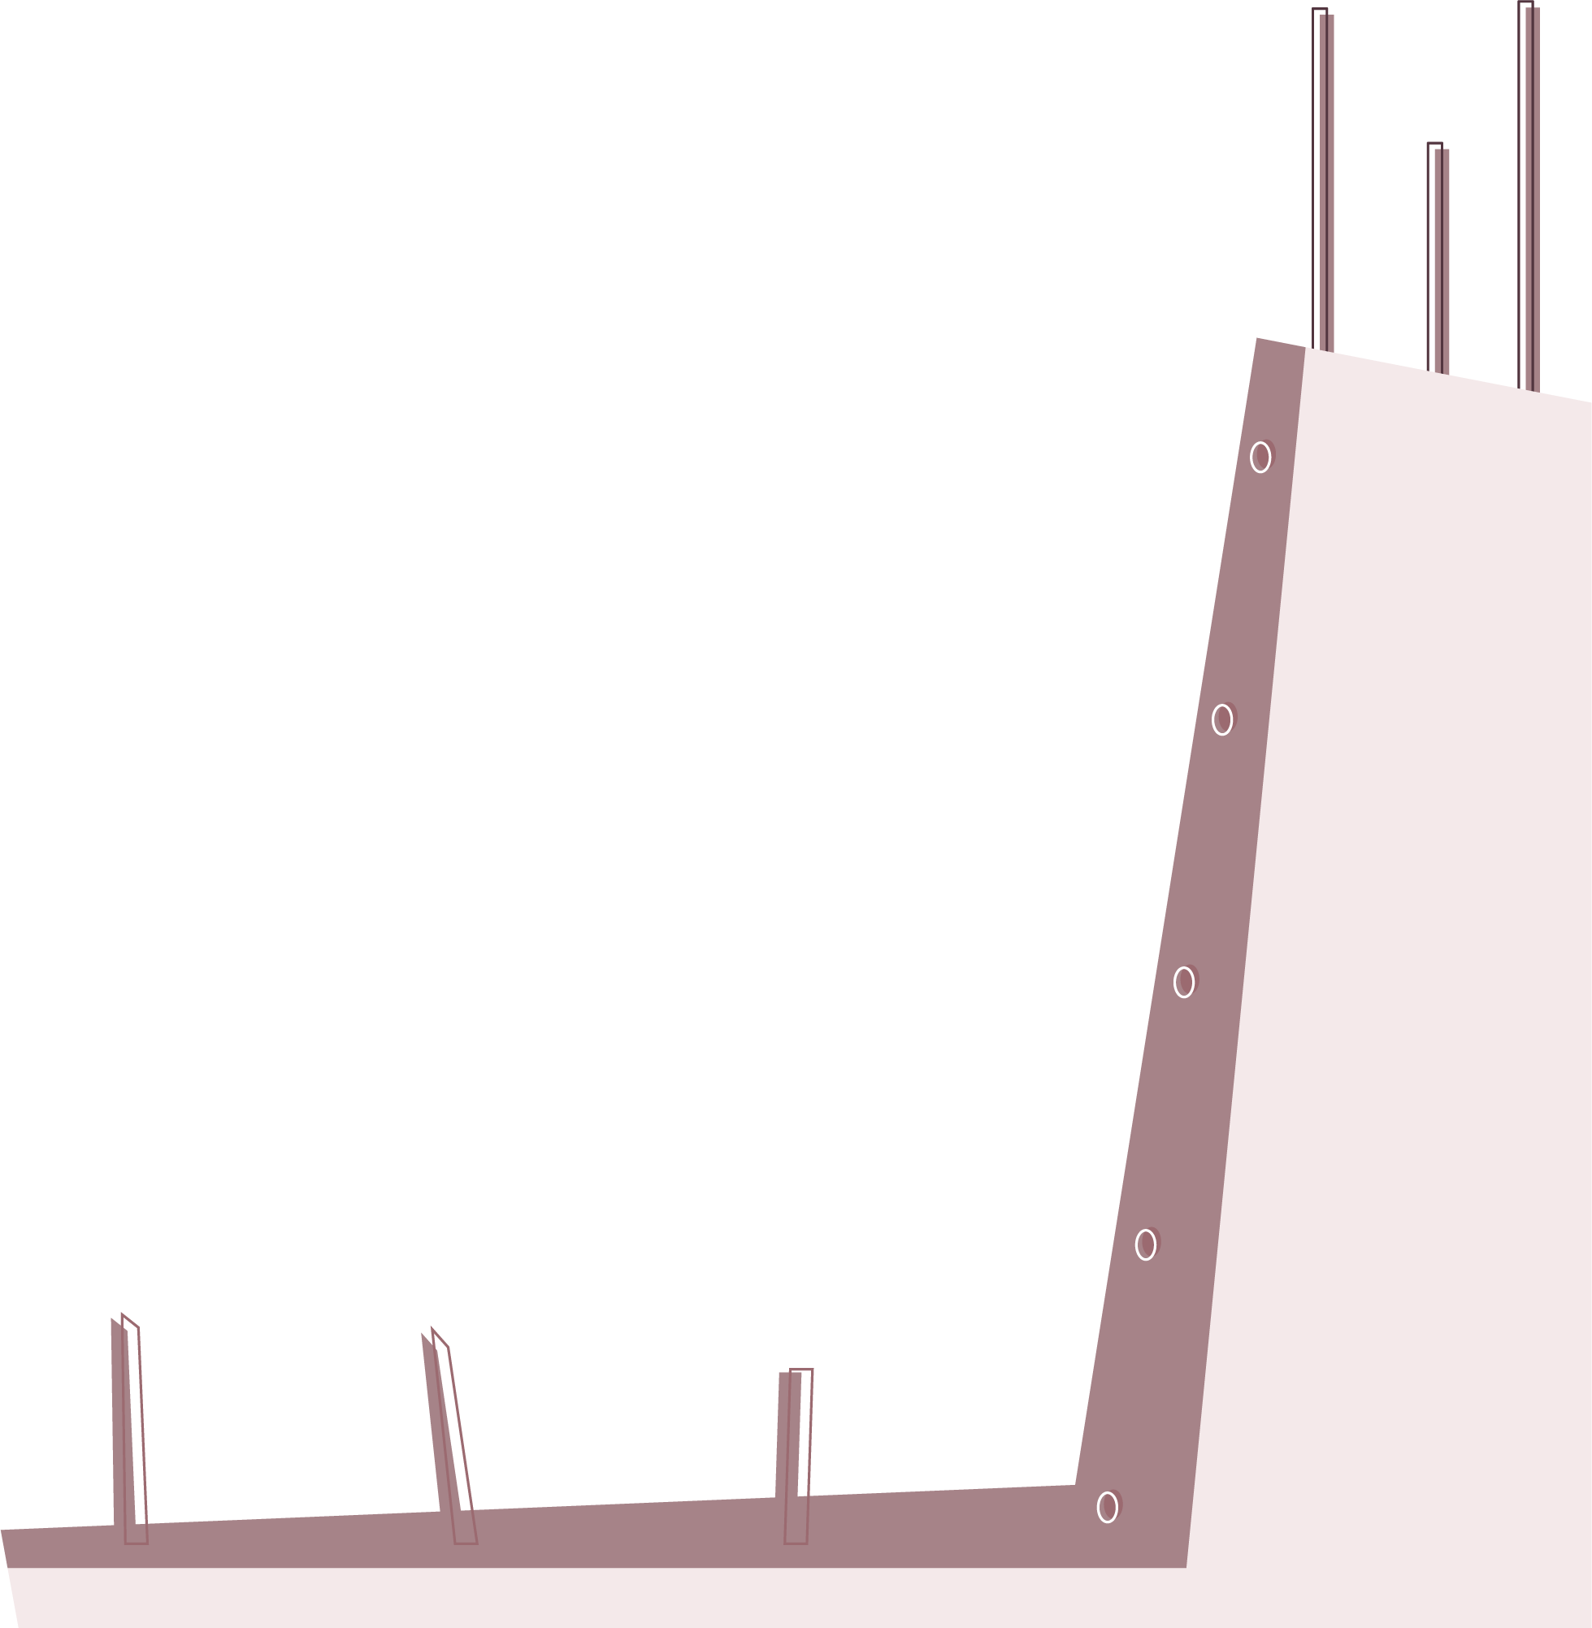
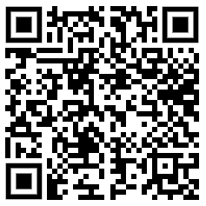

Wrap Up
How much fun did you have today?
What was your favorite part of your job site visit?
Google form:
https://forms.gle/61WEV9rdt6nsu1478

