Slide 1
BYF
CONSTRUCTION CLUB
Session 2

Slide 2
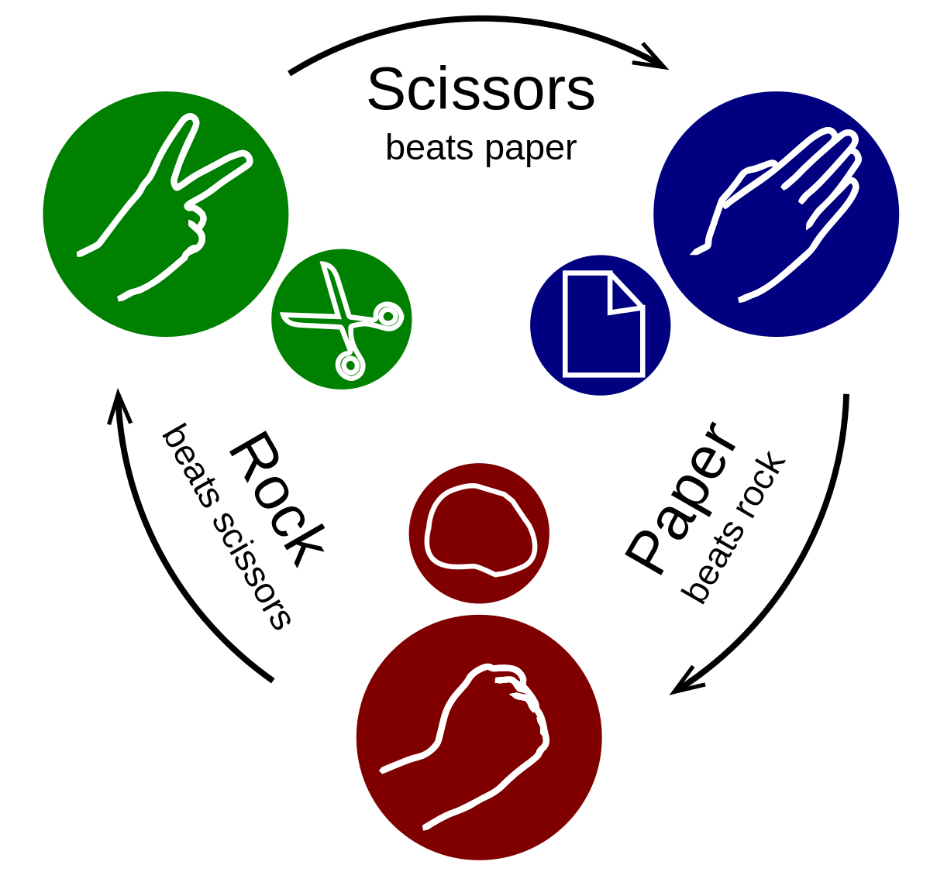
Greeting
Hammer, Blueprint, Architect
Hammer=Rock
Blueprint=Paper
Architect=Scissors

Slide 3
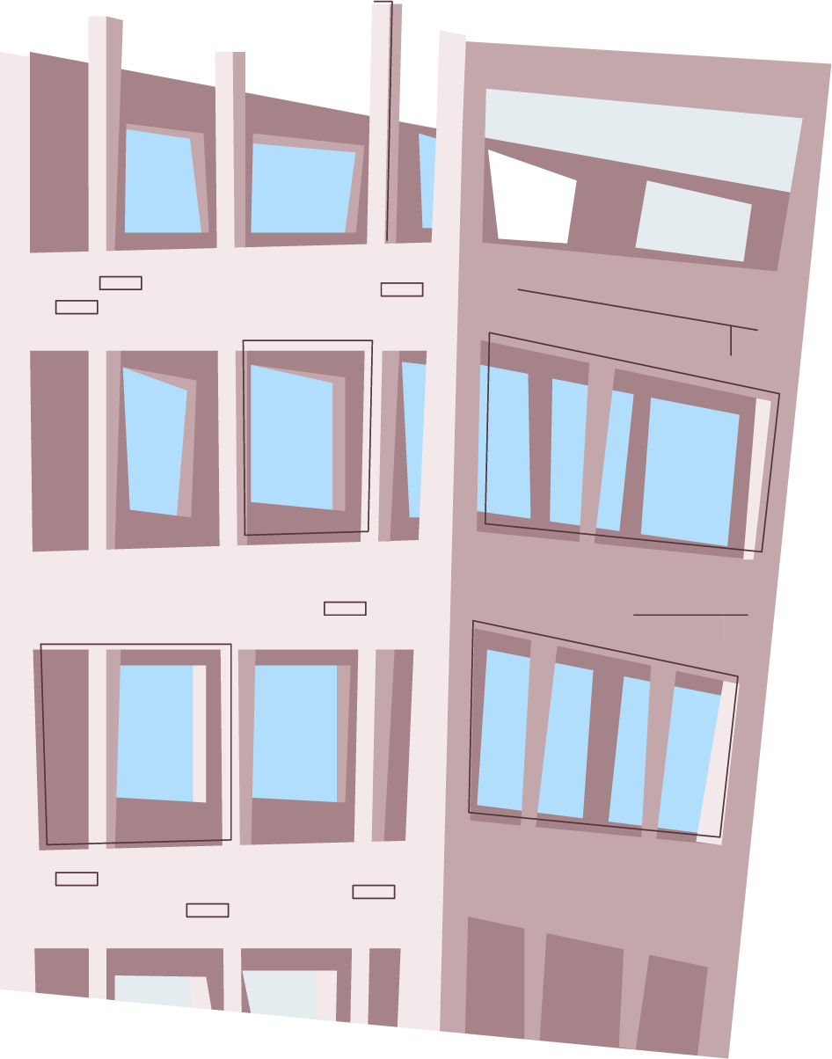
Today’s project: Birdhouse
You will use a hammer and screwdriver to put together a birdhouse. Then, you will sand and paint it!

Slide 4
Objectives
01
02
03
04
Following directions
Teamwork
Ability to hear and execute directions accurately
Working together to accomplish a goal
Using basic tools
Sanding
Working with a hammer and screwdriver
Using sandaper with the grain of the wood to make a smooth finish

Slide 5
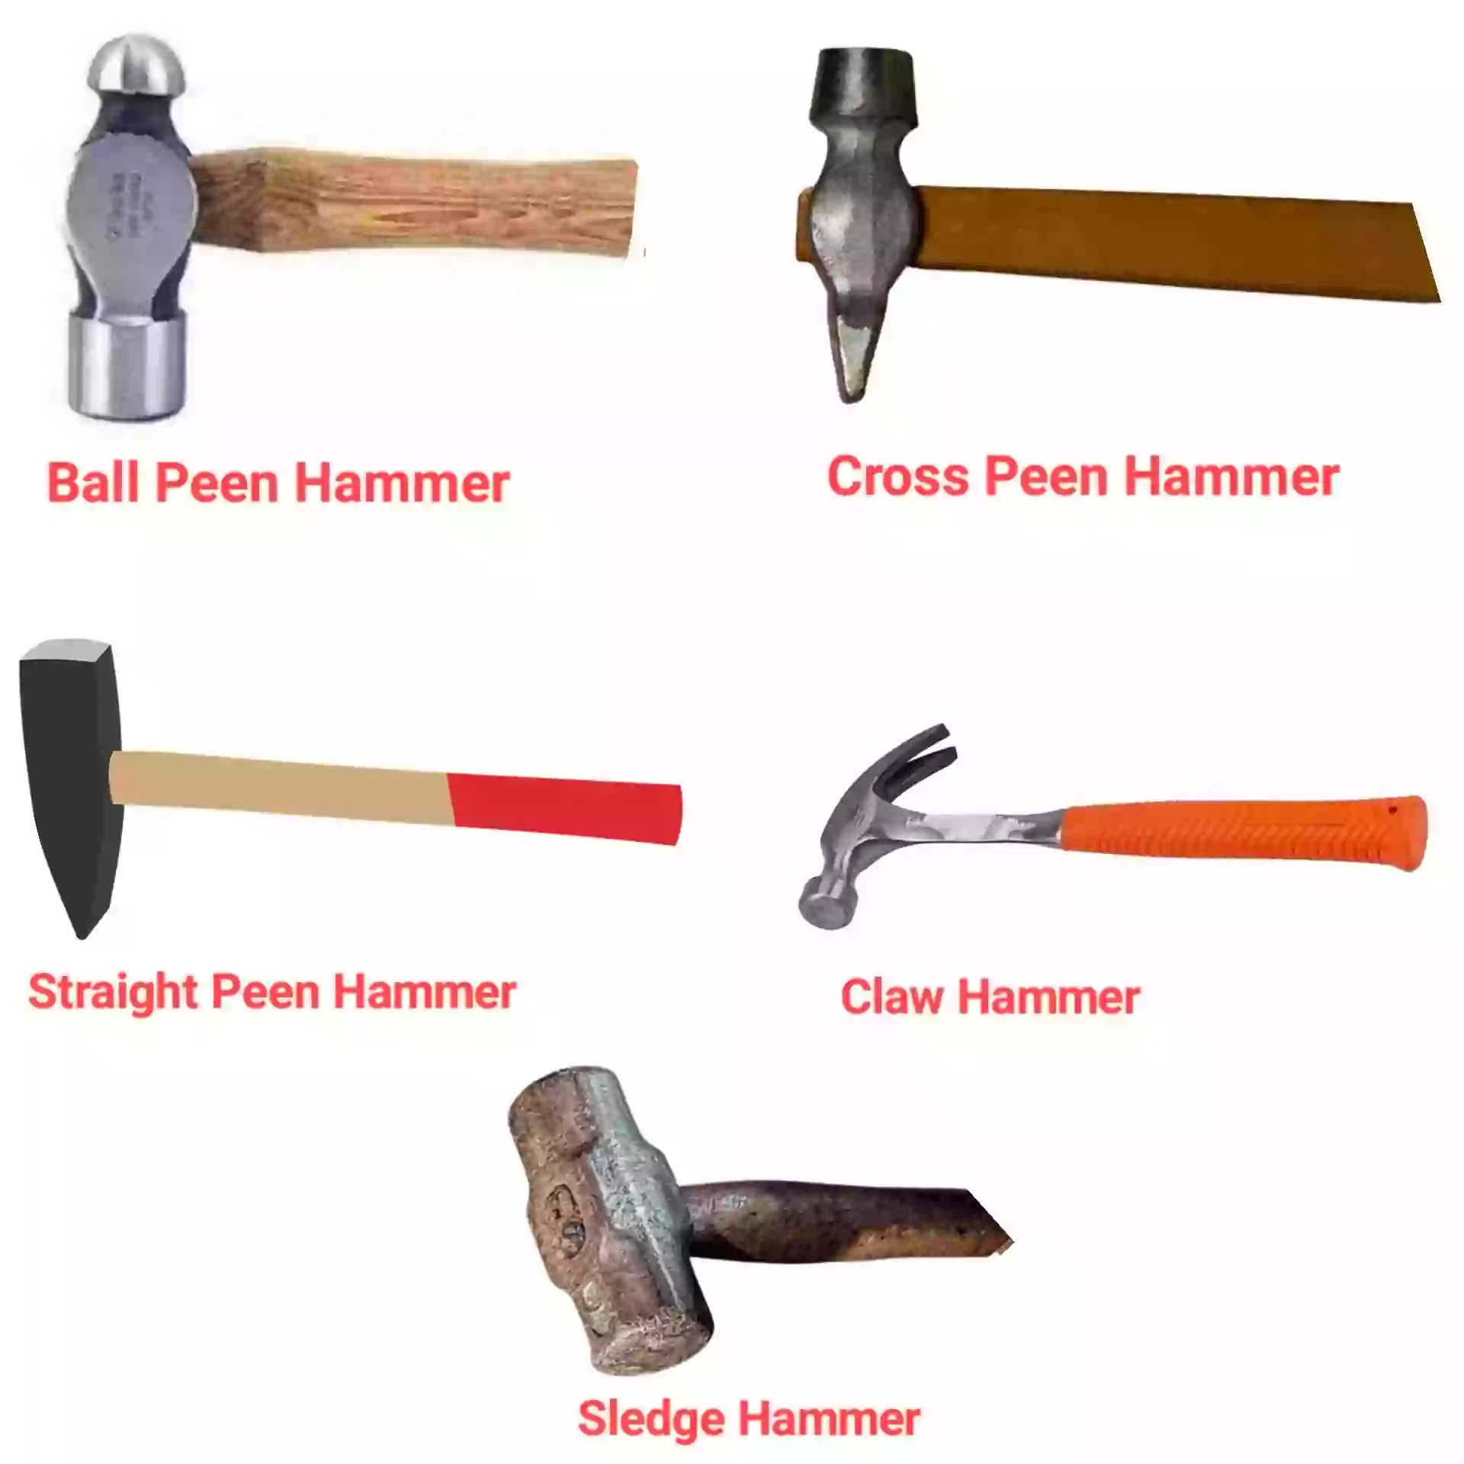
Tools: Hammer
Claw Hammer
Generally associated with carpentry and similar crafts
Used to drive a nail, wedge, or dowel
Claw is used to pull nails out of wood
https://www.youtube.com/watch?v=g6dvj4MKjDc

Slide 6
Properly driven nails

Slide 7
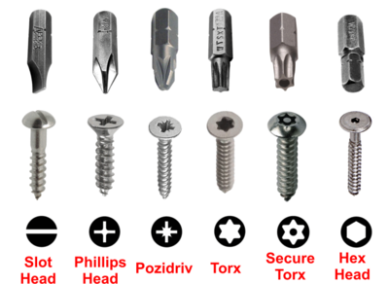
Tools: Screwdriver

Slide 8
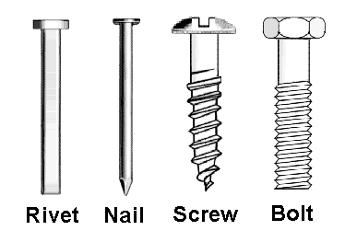
Types of fasteners

Slide 9
Materials Needed
1 hammer per group
Screwdrivers to share
Birdhouse kit per group
Safety glasses
Sandpaper
Access to technology

Slide 10
But first, SAFETY
Safety glasses on when “on-site”
Be responsible for your own part
Watch your fingers!
Clean up after yourself

Slide 11
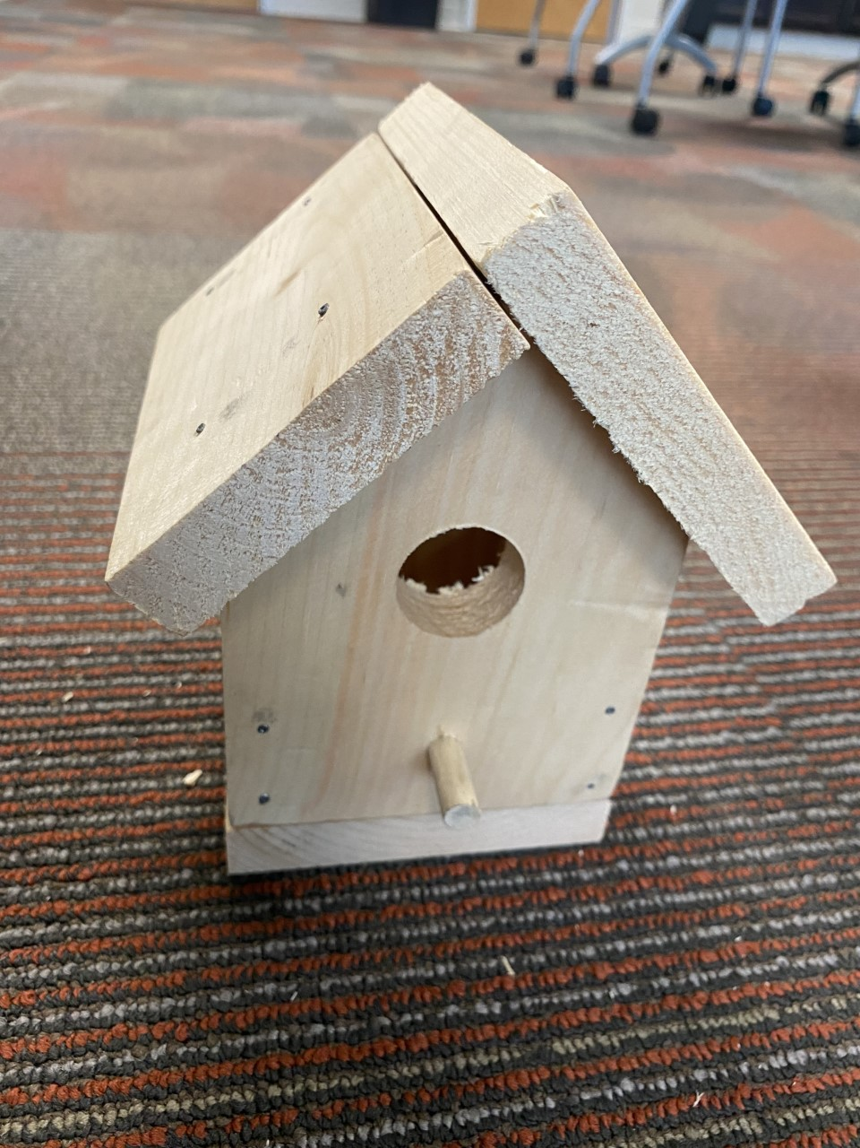
Process
First
Then
Check your materials!
Front
Back
Bottom
2 sides
Long top
Short top
16 Nails
2 screws
Peg
Pre-planning: Work with your team to hold the pieces together with your hands to make sure you know where each piece goes!

Slide 12
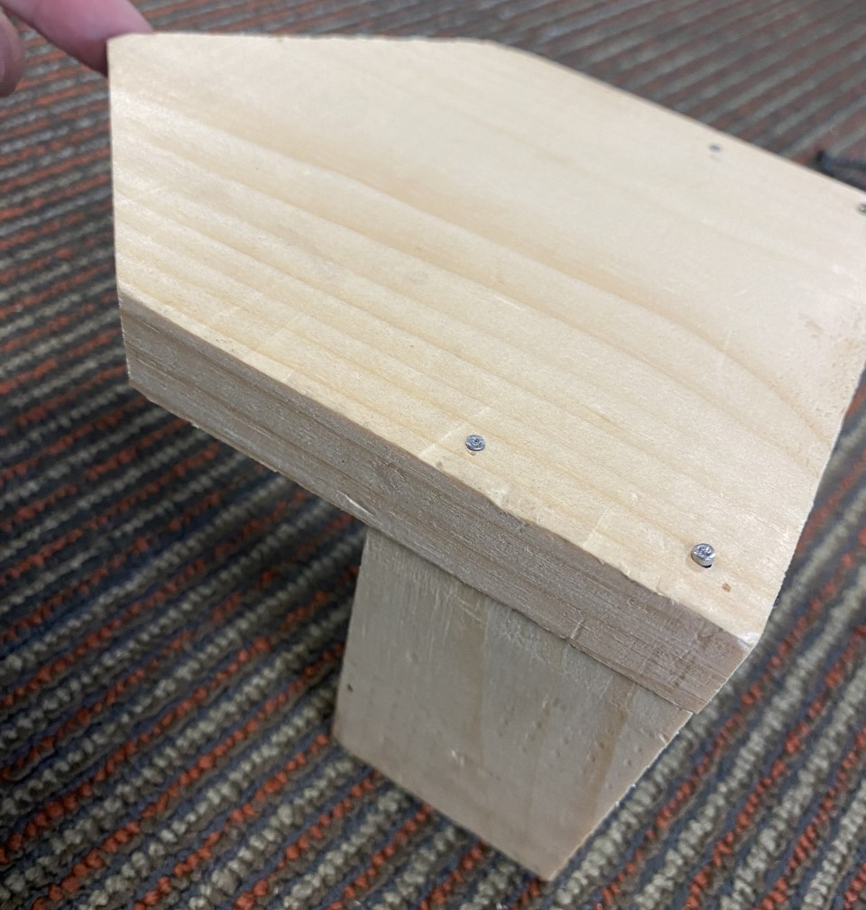
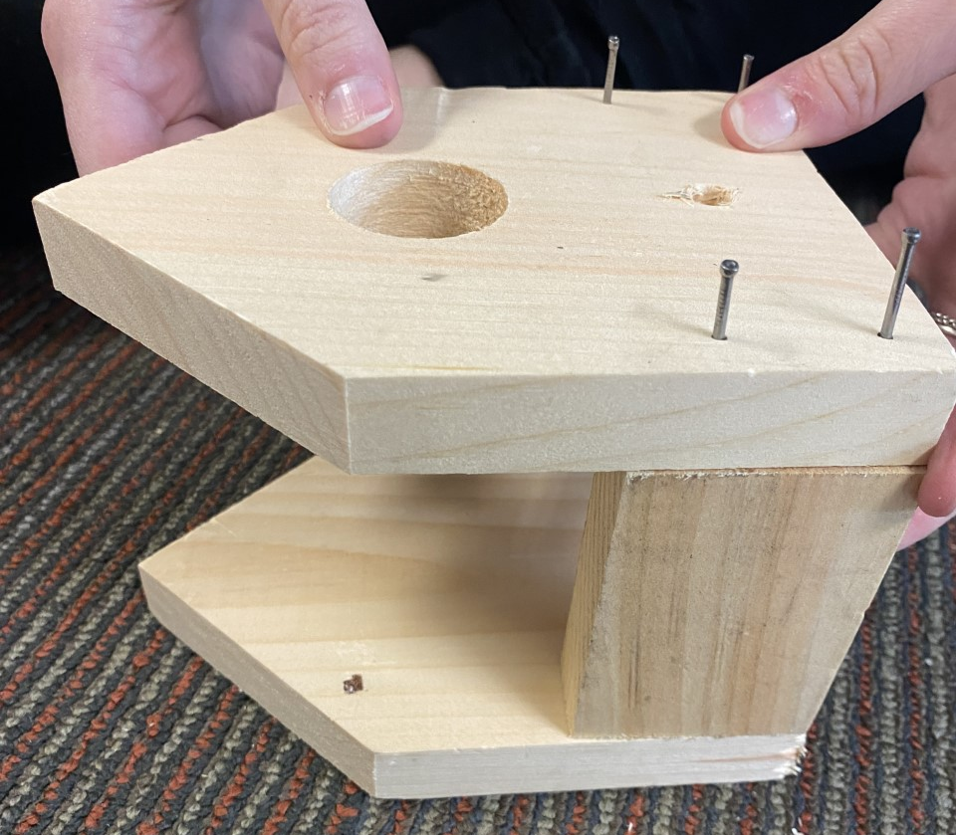
Process
Next
Then

Slide 13
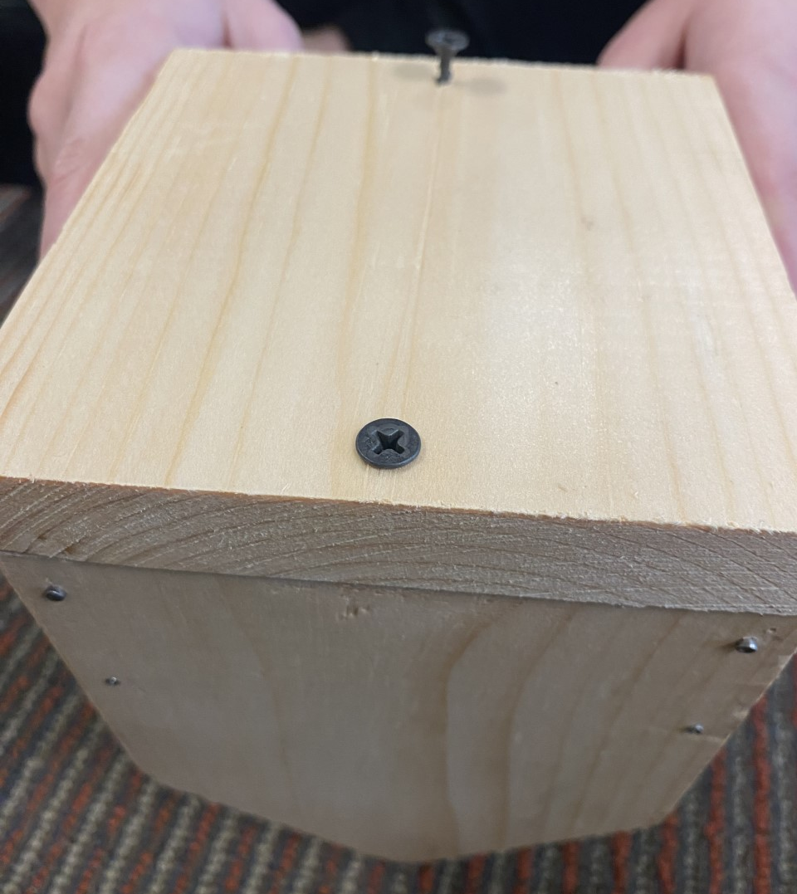
Process
Next
Then

Slide 14
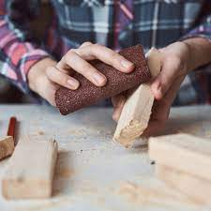
Process
Next
Last

Slide 16
JOB EXPLORATION

Slide 17
Residential Construction Careers
Building houses, or residences, where people live
How was our build today residential?
What else would you need to think about if you built a house for people?

Slide 19
Plan It: Real Estate Developer
Average Salary: $35,000 to $60,000 to $160,000+
Description: Identify housing and commercial development needs. Locate land while understanding zoning and financial processes involved with developing. Work closely with engineers, contractors, land-owners, and government employees
Education Options: Bachelor’s degree +experience
Qualifications: Research, persuasive, creative, problem solver, good under pressure

Slide 20
Build It: Carpenter
Average Salary: $56,877
Description: Measure, cut, and shape wood, plastic, fiberglass, and drywall; construct, install, and repair structures and fixtures
Education Options: Technical School, Community College, Registered Apprenticeship Program, and Industry Training Program
Qualifications: Coordination, manual dexterity, physical fitness, balance, ability to solve math problems quickly and accurately

Slide 21
Build It: Roofer
Average Salary: $42,780
Description: Use materials like shingles, asphalt, wood, and aluminum to build roofs that cover structures such as houses, malls, and hospitals
Education Options: Technical School, Community College, Registered Apprenticeship Program, and Industry Training Program
Qualifications: Coordination, balance

Slide 22
Finish It: Electrician
Average Salary: $67,269
Description: Install and maintain electrical and power systems for homes, business, and factories
Education Options: Technical School, Community College, Registered Apprenticeship Program, and Industry Training Program
Qualifications: Manual dexterity, coordination, physical fitness, good balance, good color vision (to recognize electrical wires)
https://youtu.be/u5ypG1rdwe8
https://youtu.be/AfSISgTo7QQ
https://youtu.be/Akm2O66z8M0

Slide 23
Finish It: Plumber
Average Salary: $59,627
Description: Design and install piping systems that distribute water and remove waste from buildings, and connect heating and cooling systems
Education Options: Technical School, Community College, Registered Apprenticeship Program, and Industry Training Program
Qualifications: knowledgeable in water distribution, blueprint reading, local ordinances and regulations, mathematics, mechanical drawing, physics, welding, and soldering
https://youtu.be/qnvNZvdqC7c

Slide 24
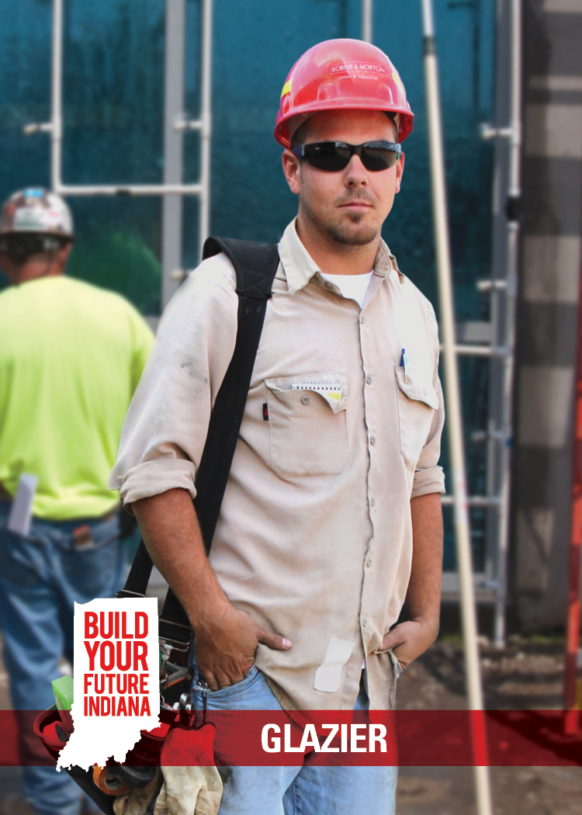
Finish It: Glazier
Average Salary: $47,480
Description: Select, cut, install, replace, and remove residential, commercial, and artistic glass. Use a variety of tools including glazing knives, saws, drills, grinders, putty, and glazing compounds
Education Options: Technical School, Community College, Registered Apprenticeship Program, and Industry Training Program
Qualifications: Ability to mold and manipulate objects while paying attention to detail. Balance and coordination are a must on ladders and scaffolds.

Slide 25
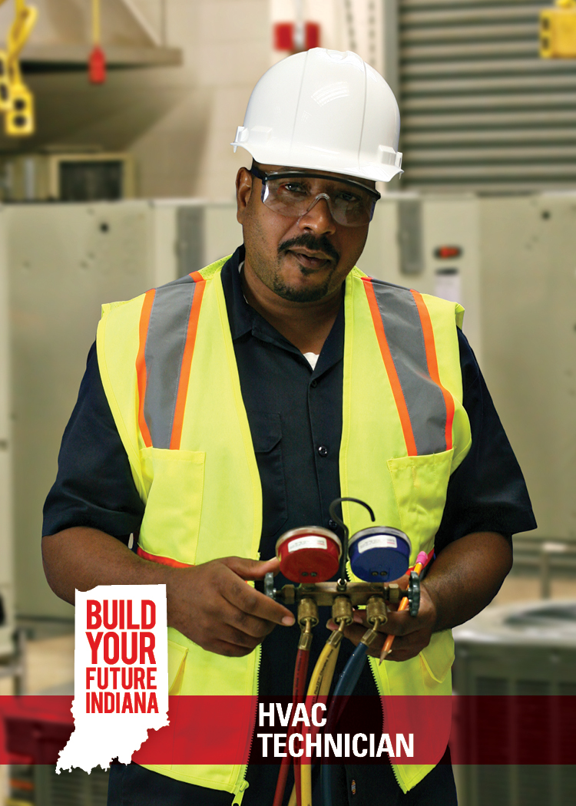
Finish It: HVAC Technician
Average Salary: $62,472
Description: Install, maintain, and repair heating, ventilation, and air conditioning systems (Can include motors, compressors, pumps, fans, thermostats, and computerized switches control systems, hydronics, solar panels, or commercial refrigeration)
Education Options: Technical School, Community College, Registered Apprenticeship Program, and Industry Training Program
Qualifications: Coordination, physical dexterity, mechanical and mathematical aptitude

Slide 26
Wrap Up
What career you learned about today sounds the most interesting?
Why does that career sound interesting?
How much fun did you have today?
Google form:
https://forms.gle/asANxz8oJZFhCQh46

