Slide 1


BYF
CONSTRUCTION CLUB
Session 1

Slide 2
Greeting
Teams of 6.
Round 1: Alphabetical order by first name—without using words!
Round 2: Alphabetical by last name—without using words!
Round 3: Birthday—again, no words!

Slide 3
Objectives
01
02
03
04
Patience
Teamwork
Ability to wait without getting upset
Working together to accomplish one goal
Integrity
Concrete skills
Doing what you are supposed to do, even when no one is looking
Mixing and pouring

Slide 4
Materials Needed
Computers/tablets
Safety glasses
Concrete mix
Cups
Stirring sticks
Concrete mold
Magnets
Shape set
Catapult
Marshmallows

Slide 5
WATCH
https://www.youtube.com/watch?v=v-aqazCa4So

Slide 6
CIVIL CONSTRUCTION CAREERS
Building roads and bridges
Cement Mason
Concrete Finisher
Builds structures from concrete
Levels concrete
Cement Pourer
Operator Engineer
Drives cement truck and oversees cement leaving truck
Operates heavy equiptment needed to construct roads
Cement Laborer
Civil Engineer
Distributes cement within alotted area
Plans roads, bridges, and other projects

Slide 7

Why a career in construction?

Slide 8
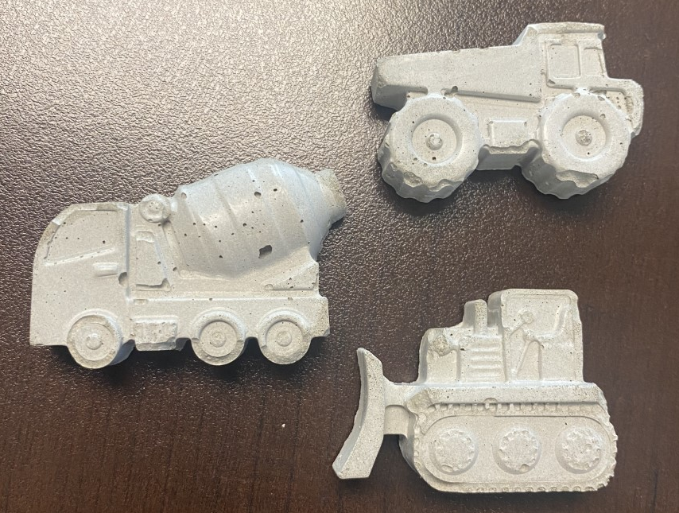

Today’s project:
Concrete magnets
You will form the concrete, add a magnet, and paint your design!

Slide 9
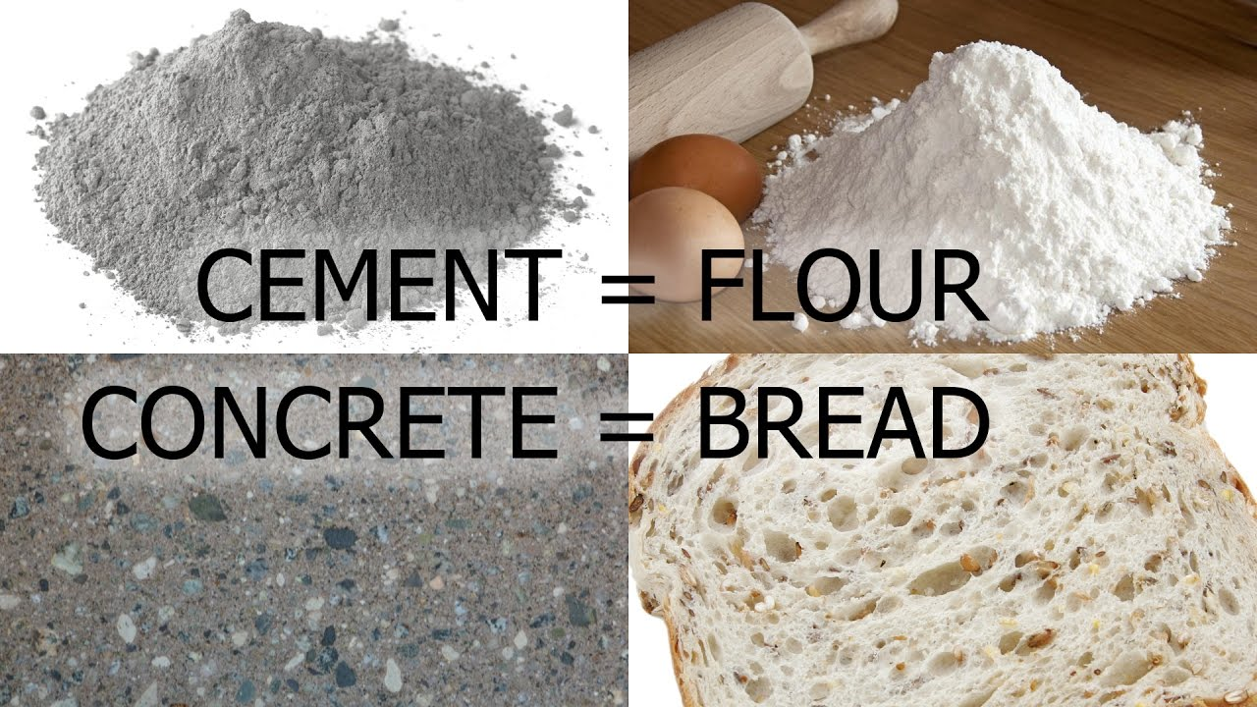
Concrete vs. Cement

Slide 10


But first, SAFETY
Safety glasses on when “on-site”
Be careful
Stay in your area
Clean up after yourself

Slide 11
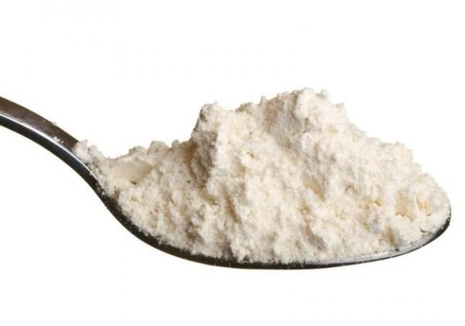

Process
First
Then

Slide 12
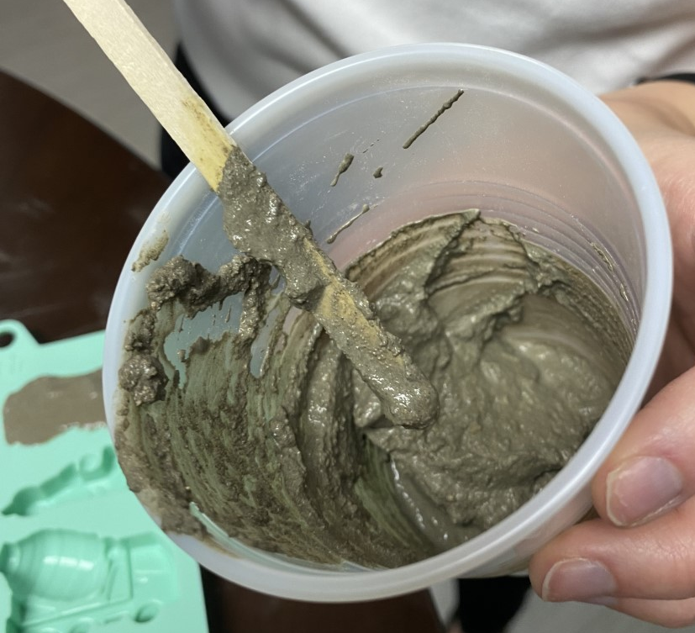
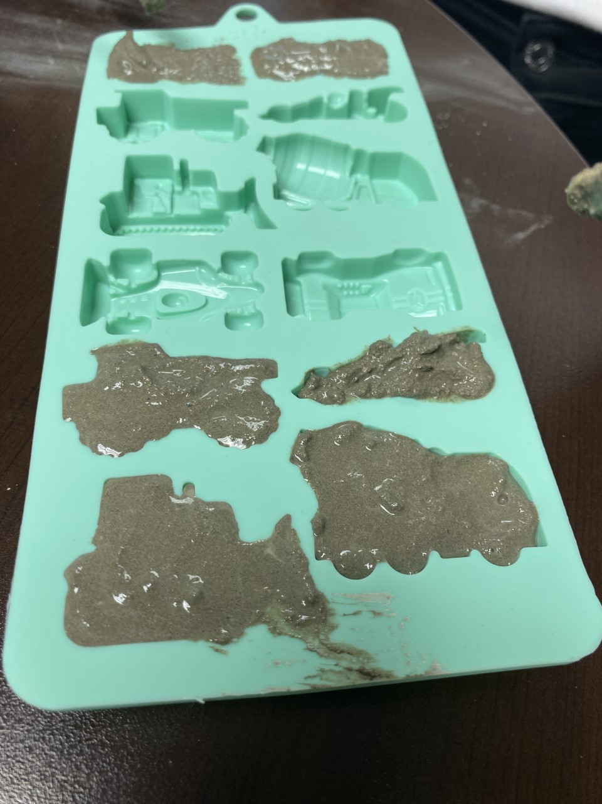
Process
Next
Then

Slide 13
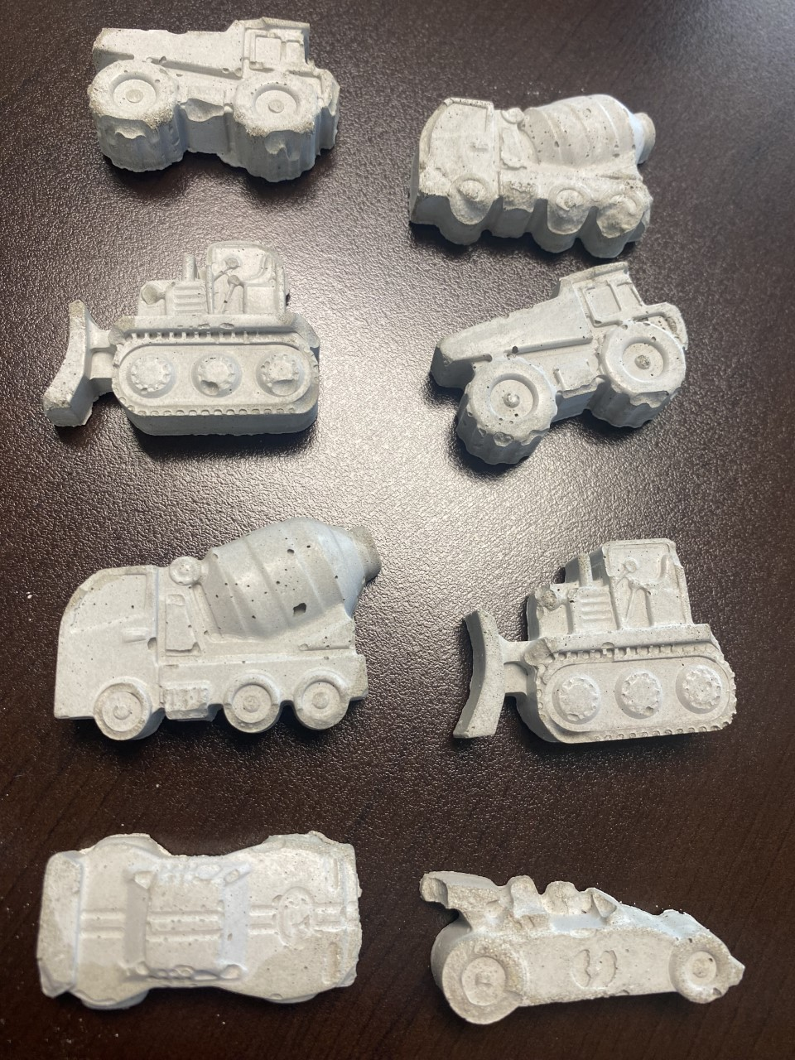

Process
Next
Last

Slide 14

CAREER QUIZ
“If opportunity doesn’t knock, build a door.”
-Milton Berle
https://indiana.byf.org/
Menu>Career Quiz/

Slide 15
Small Group Discussion
Share your results with your group.
Do any of you have jobs in common?
Were you surprised at all? Why or why not?
Which job result are you most excited about? Why?

Slide 16
Whole Group Discussion
What were your three most exciting jobs?
Why were they exciting?

Slide 17
Club overview
Session 1
Session 2
Session 3
Concrete Magnets
Wooden Birdhouses
Painting
Session 4
Session 5
Session 6
Job Site Visit
Racecar
Structures

Slide 18

Roles
Project Manager
Laborer
Oversees project
Manages team
Gives directions
Timekeeper
Checks for safety
Uses tools
Monitors area

Slide 19
Project Manager Game
Roles
Goal
1 person is the Project Manager
Everyone else is a Laborer
The project manager will accurately communicate the picture and the laborers will recreate it. Only the laborers are able to touch the materials.

Slide 20
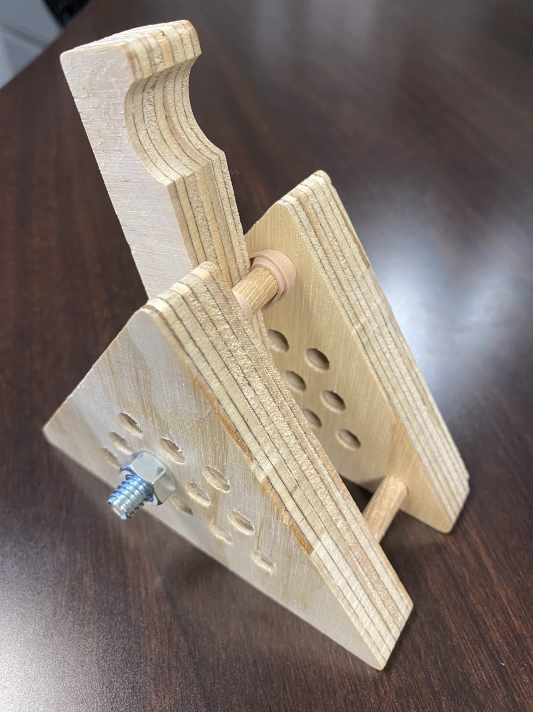
Today’s project:
Catapult
You will work with your group to insert the dowls, tighten the bolt, and attach the rubber band.

Slide 21

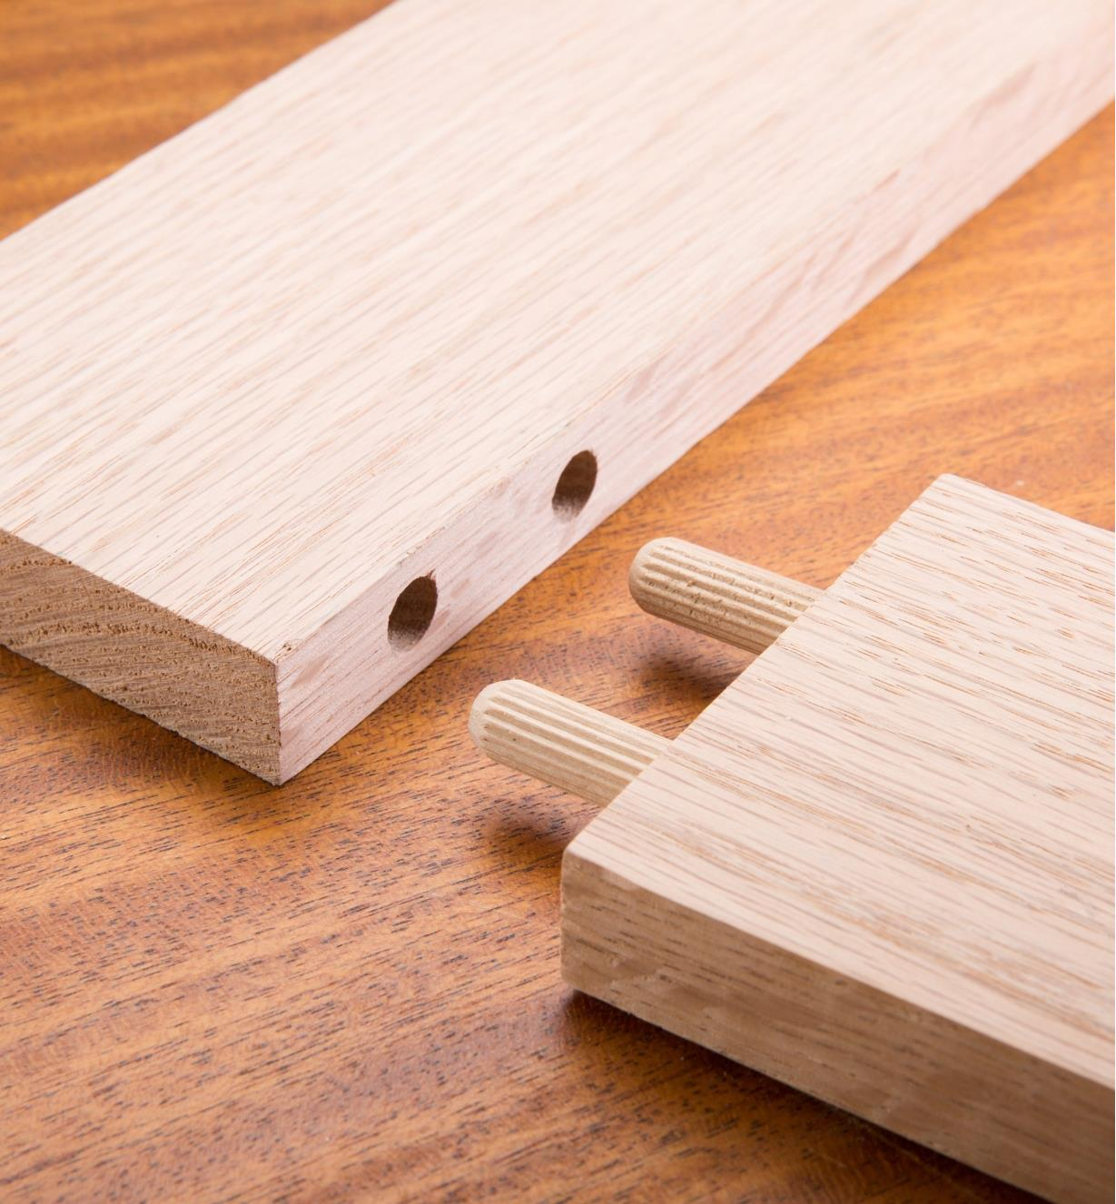
Tools: Dowel
A dowel is used to hold together components of a structure. Dowels are much thicker and sturdier than screws or nails, which as a results makes them perfect for furniture or cabinet making. Today we will use dowels to keep our catapults together!

Slide 22
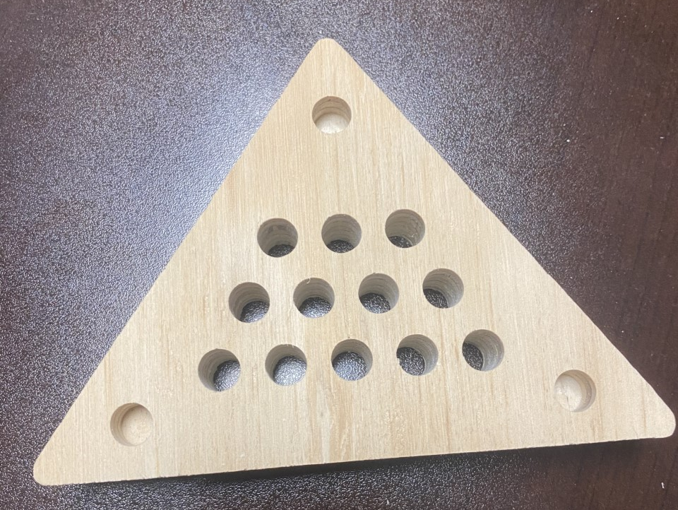
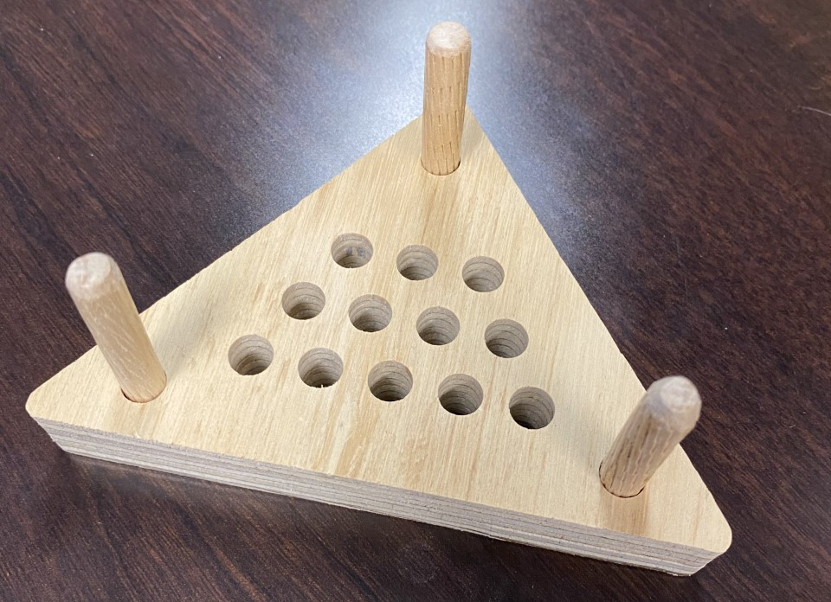
Process
First
Then

Slide 23
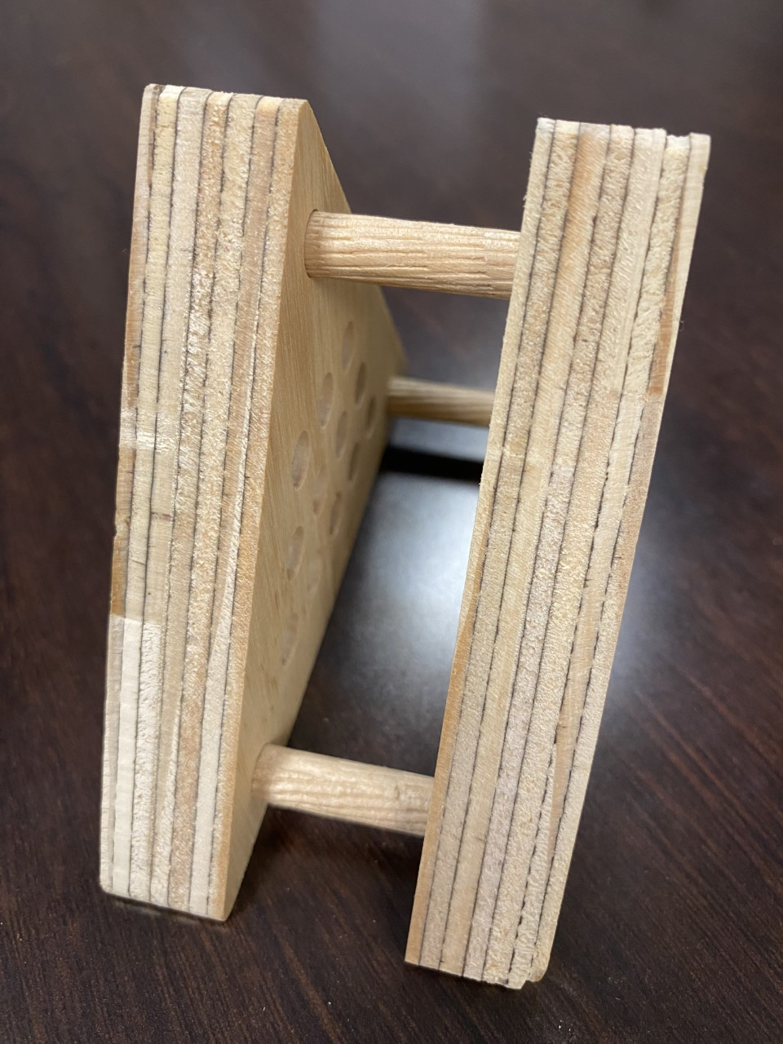
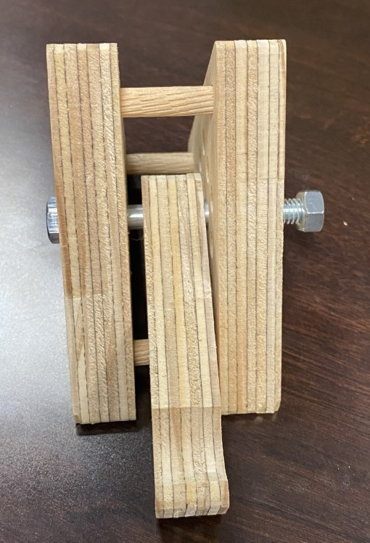
Process
Next
Then

Slide 24
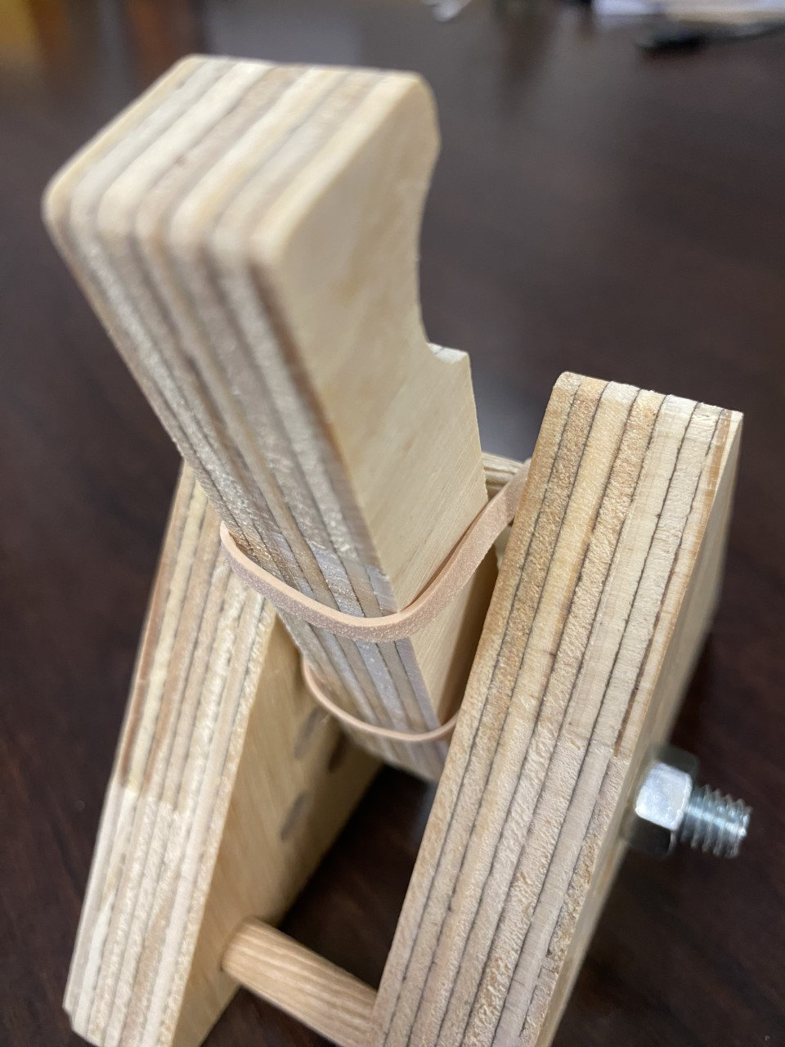
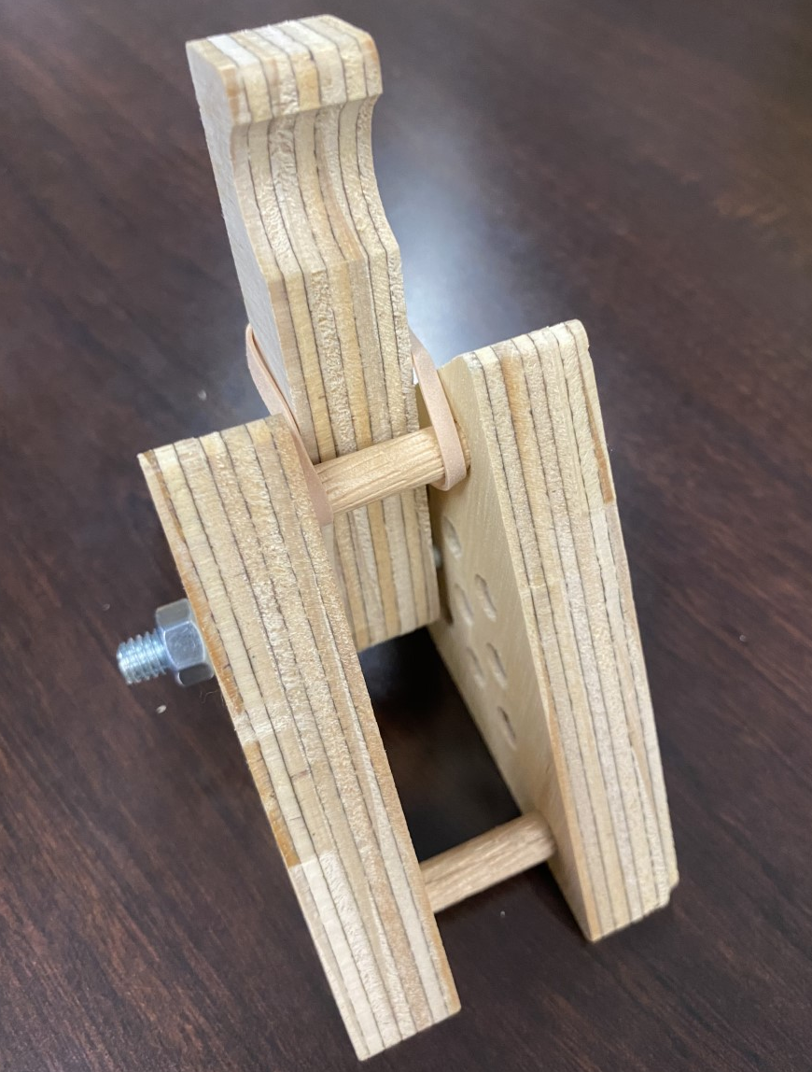
Process
Last

Slide 25
JOB
EXPLORATION

Slide 26




Slide 27

Plan It: Estimator
Average Salary: $35,00 to $60,000 to$100,000+ Description: Collect information to determine the amount of time, money, materials, and labor a build will take. Create bids based on analyzing numbers and calculating total cost.
Education Options: Bachelor’s degree without experience, or high school diploma if coming from construction field
Qualifications: Research, ability to find trends and patterns, perform under pressure, problem solver

Slide 28

Plan It: Project Manager
Average Salary: $46,00 to $66,000 to$110,000+ Description: Keep projects running on time and on budget. Plan, coordinate, budget, and supervise projects from development to completion.
Education Options: Bachelor’s degree and on the job training
Qualifications: Personable, persuasive, creative, perform under pressure, problem solver, detail oriented

Slide 29

Build It: Cement Mason
Average Salary: $56,784
Description: Use bricks, concrete blocks, and natural stones to build attractive, durable surfaces and structures. Masons create buildings, walls, and roads!
Education Options: Technical School, Community College, Registered Apprenticeship Program, and Industry Training Program
Qualifications: Strong work ethic, dependability, basic math skills

Slide 30
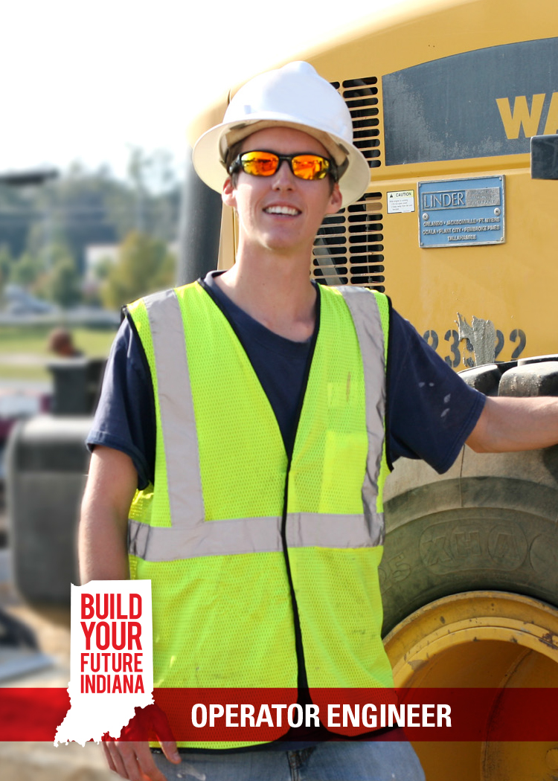
Build It: Operator Engineer
Average Salary: $58,429
Description: Clear and grade land for the construction of roads, buildings, bridges, airport runways, power generation facilities, dams, levees, and other structures.
Education Options: Technical School, Community College, Registered Apprenticeship Program, and Industry Training Program
Qualifications: Mechanical aptitude, experience operating mobile equipment (such as farm tractors), good physical condition, sense of balance, coordination

Slide 31

Wrap Up
Why did you join construction club?
What was your favorite career opportunity from the quiz?
How much fun did you have today?
Google form:
https://forms.gle/dB9ZncU7ajmQNRE16

Slide 32

Leave your catapults to be used for
demolition later on!

