Slide 2
Plan It: Estimator
Average Salary: $35,00 to $60,000 to$100,000+ Description: Collect information to determine the amount of time, money, materials, and labor a build will take. Create bids based on analyzing numbers and calculating total cost.
Education Options: Bachelor’s degree without experience, or high school diploma if coming from construction field
Qualifications: Research, ability to find trends and patterns, perform under pressure, problem solver

Slide 3
Plan It: Project Manager
Average Salary: $46,00 to $66,000 to$110,000+ Description: Keep projects running on time and on budget. Plan, coordinate, budget, and supervise projects from development to completion.
Education Options: Bachelor’s degree and on the job training
Qualifications: Personable, persuasive, creative, perform under pressure, problem solver, detail oriented

Slide 4
Build It: Cement Mason
Average Salary: $56,784
Description: Use bricks, concrete blocks, and natural stones to build attractive, durable surfaces and structures. Masons create buildings, walls, and roads!
Education Options: Technical School, Community College, Registered Apprenticeship Program, and Industry Training Program
Qualifications: Strong work ethic, dependability, basic math skills

Slide 5
Build It: Operator Engineer
Average Salary: $58,429
Description: Clear and grade land for the construction of roads, buildings, bridges, airport runways, power generation facilities, dams, levees, and other structures.
Education Options: Technical School, Community College, Registered Apprenticeship Program, and Industry Training Program
Qualifications: Mechanical aptitude, experience operating mobile equipment (such as farm tractors), good physical condition, sense of balance, coordination

Slide 6
Plan It: Real Estate Developer
Average Salary: $35,000 to $60,000 to $160,000+
Description: Identify housing and commercial development needs. Locate land while understanding zoning and financial processes involved with developing. Work closely with engineers, contractors, land-owners, and government employees
Education Options: Bachelor’s degree +experience
Qualifications: Research, persuasive, creative, problem solver, good under pressure

Slide 7
Build It: Carpenter
Average Salary: $56,877
Description: Measure, cut, and shape wood, plastic, fiberglass, and drywall; construct, install, and repair structures and fixtures
Education Options: Technical School, Community College, Registered Apprenticeship Program, and Industry Training Program
Qualifications: Coordination, manual dexterity, physical fitness, balance, ability to solve math problems quickly and accurately

Slide 8
Build It: Roofer
Average Salary: $42,780
Description: Use materials like shingles, asphalt, wood, and aluminum to build roofs that cover structures such as houses, malls, and hospitals
Education Options: Technical School, Community College, Registered Apprenticeship Program, and Industry Training Program
Qualifications: Coordination, balance

Slide 9
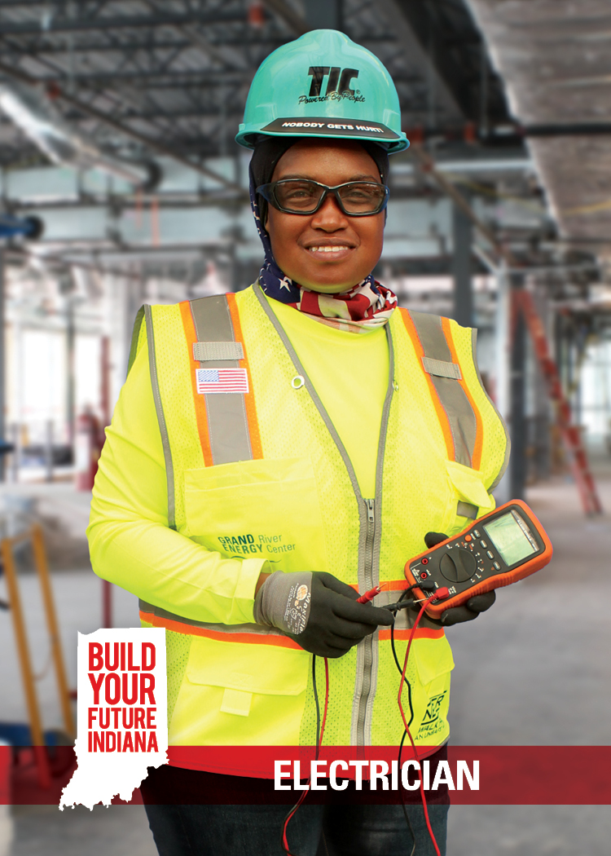
Finish It: Electrician
Average Salary: $67,269
Description: Install and maintain electrical and power systems for homes, business, and factories
Education Options: Technical School, Community College, Registered Apprenticeship Program, and Industry Training Program
Qualifications: Manual dexterity, coordination, physical fitness, good balance, good color vision (to recognize electrical wires)
https://youtu.be/u5ypG1rdwe8
https://youtu.be/AfSISgTo7QQ
https://youtu.be/Akm2O66z8M0

Slide 10
Finish It: Plumber
Average Salary: $59,627
Description: Design and install piping systems that distribute water and remove waste from buildings, and connect heating and cooling systems
Education Options: Technical School, Community College, Registered Apprenticeship Program, and Industry Training Program
Qualifications: knowledgeable in water distribution, blueprint reading, local ordinances and regulations, mathematics, mechanical drawing, physics, welding, and soldering
https://youtu.be/qnvNZvdqC7c

Slide 11
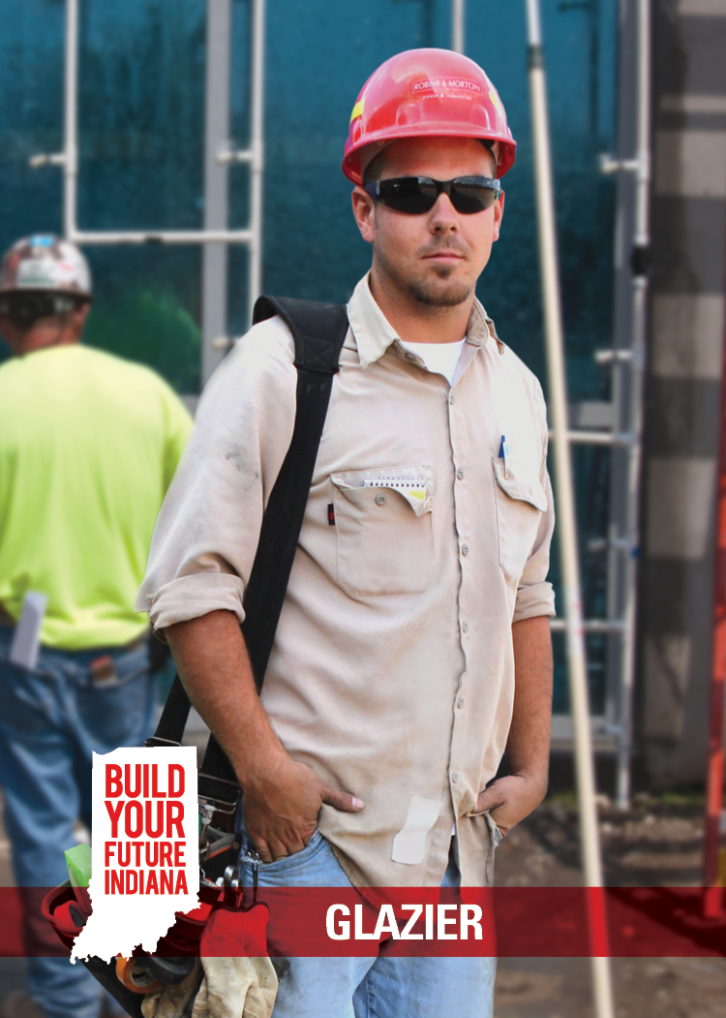
Finish It: Glazier
Average Salary: $47,480
Description: Select, cut, install, replace, and remove residential, commercial, and artistic glass. Use a variety of tools including glazing knives, saws, drills, grinders, putty, and glazing compounds
Education Options: Technical School, Community College, Registered Apprenticeship Program, and Industry Training Program
Qualifications: Ability to mold and manipulate objects while paying attention to detail. Balance and coordination are a must on ladders and scaffolds.

Slide 12
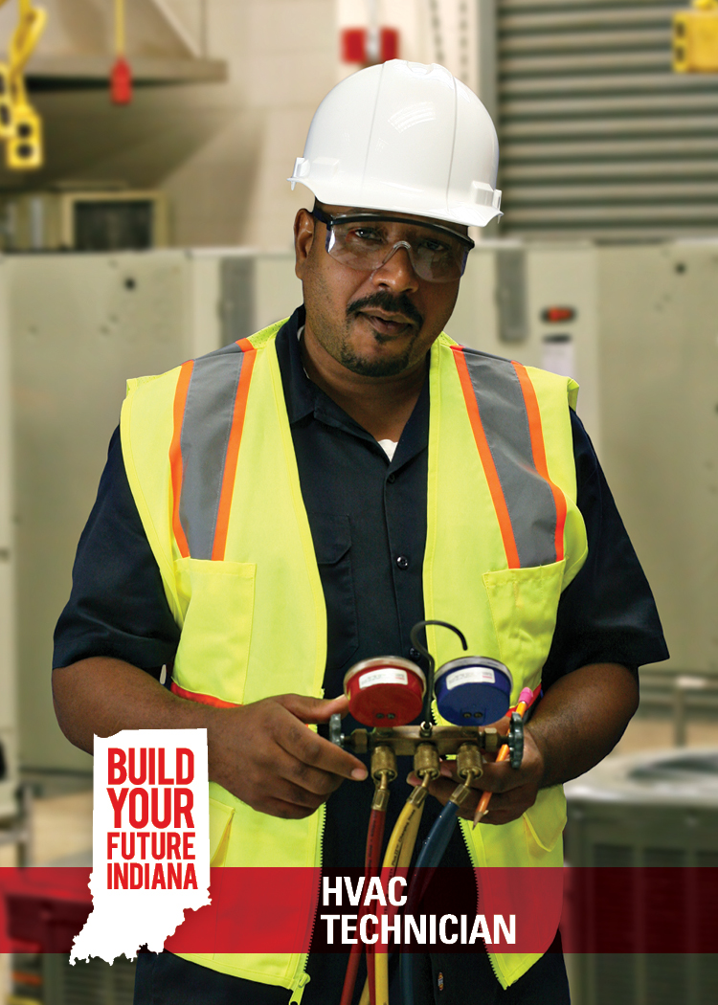
Finish It: HVAC Technician
Average Salary: $62,472
Description: Install, maintain, and repair heating, ventilation, and air conditioning systems (Can include motors, compressors, pumps, fans, thermostats, and computerized switches control systems, hydronics, solar panels, or commercial refrigeration)
Education Options: Technical School, Community College, Registered Apprenticeship Program, and Industry Training Program
Qualifications: Coordination, physical dexterity, mechanical and mathematical aptitude

Slide 13
Plan It: Builder/Remodeler
Average Salary: $50,000 to $85,000 to $250,000+
Description: Manage teams that build and remodel homes and buildings. Prepare and clean sites and assist in logistics of project. Can help create budgets, blueprints, and sketches.
Education Options: High school or GED and apprenticeship programs
Qualifications: problem solving, interpersonal skills, physically fit, personable, creative, persuasive, good under pressure, ability to use technology

Slide 14
Build It: Tower Crane Operator
Average Salary: $66,329
Description: Use their knowledge of load calculations and crane operations to hoist heavy materials off the ground and to significant heights
Education Options: Technical School, Community College, Registered Apprenticeship Program, and Industry Training Program
Qualifications: Balance, ability to judge distance, coordination, comfortable with technology, basic math skills
https://youtu.be/fDfsMZhMg4U

Slide 15
Build It: Mobile Crane Operator
Average Salary: $66,119
Description: Use state-of-the-art heavy machinery to move construction materials, earth, and petroleum products over short distances
Education Options: Technical School, Community College, Registered Apprenticeship Program, and Industry Training Program
Qualifications: Balance, ability to judge distance, coordination, comfortable with technology, basic math skills

Slide 16
Finish It: Painter
Average Salary: $41,840
Description: Choose and apply the right paint or colors to buildings and industrial structures
Education Options: Technical School, Community College, Registered Apprenticeship Program, and Industry Training Program
Qualifications: Manual dexterity, vision, and color sense, as well as physical stamina and balance
https://youtu.be/hpgWtMaYVC4
https://youtu.be/aHrPHK_y6iA
https://youtu.be/8MZeagw0gWc?t=203

Slide 17
Finish It: Landscape Architect
Average Salary: $26,000 to $64,000 to $70,000+
Description: Plan and design outdoor spaces given a client’s needs and budget
Education Options: Bachelor’s degree
Qualifications: Personable, persuasive, creative, problem solver, good under pressure, love for outdoors

Slide 18
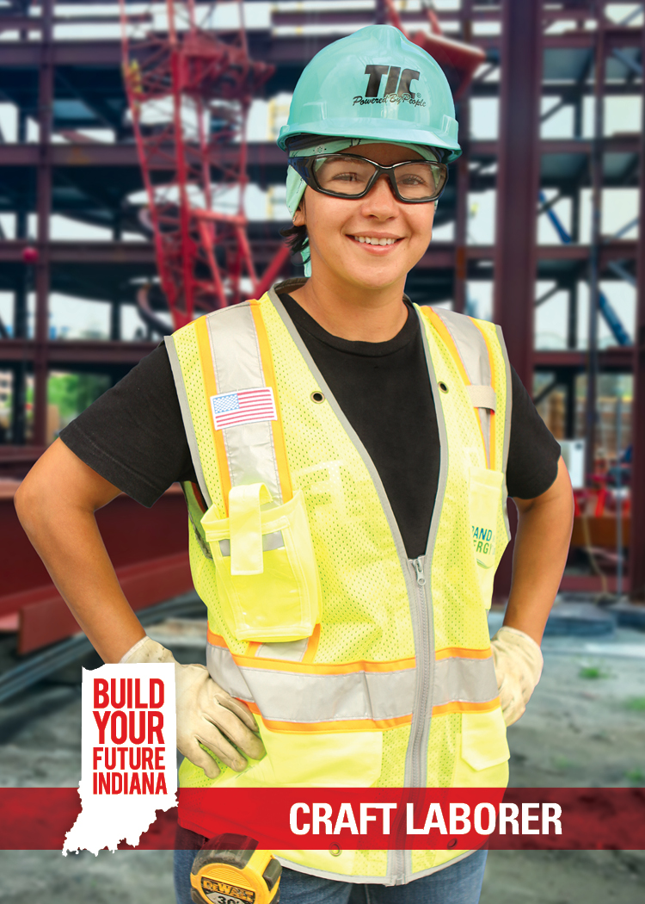
Build It: Craft Laborer
Average Salary: $38,890
Description: Perform basic tasks on a construction site, sometimes at great heights or outdoors in all weather conditions
Education Options: Technical School, Community College, Registered Apprenticeship Program, and Industry Training Program
Qualifications: Manual dexterity, coordination, physical fitness, good sense of balance

Slide 19
Build It: Millwright
Average Salary: $66,919
Description: Work on construction sites and factories assembling and disassembling machinery. Can involve technical repairs or heavy machining tools.
Education Options: Technical School, Community College, Registered Apprenticeship Program, and Industry Training Program
Qualifications: Good depth perception and manual dexterity, good judgment and decision-making skills
https://youtu.be/g-NBzo1K7UU

Slide 20
Build It: Sheet Metal Worker
Average Salary: $58,160
Description: Cut and mold sheets of metal into products for installing and repairing ventilation and air ducts; construct airplanes, automobiles, and billboards
Education Options: Technical School, Community College, Registered Apprenticeship Program, and Industry Training Program
Qualifications: Coordination, physical dexterity, mechanical and mathematics aptitude

Slide 21
Finish It: Instrumentation Technician
Average Salary: $70,080
Description: Perform key installation and maintenance functions across industries and are trained in piping, tubing, fasteners, and working with metal production
Education Options: Technical School, Community College, Registered Apprenticeship Program, and Industry Training Program
Qualifications: Manual dexterity, coordination, physical fitness, good sense of balance, problem solving

Slide 22
Plan It: Business Developer
Average Salary: $45,000 to $85,000 to $300,000+
Description: Create and maintain relationships and seek out new business opportunities. The face of the construction-related company with an end goal to lead to more business
Education Options: Bachelor’s degree is business, sometimes an MBA
Qualifications: Creative, persuasive, problem solving, spot trends and patterns, ability to perform under pressure, personable

Slide 23
Plan It: Civil Engineer
Average Salary: $91,790
Description: Design, construct, supervise, operate, and maintain large construction projects and systems including roads, buildings, airports, tunnels, dams, bridges, and systems for water supply and sewage treatment
Education Options: Bachelor’s degree, Master’s degree, and Project Management Certification
Qualifications: Problem solving, critical thinking, creativity

Slide 24
Plan It: Architect
Average Salary: $45,000 to $75,000 to $120,000+
Description: Listen to client needs and desires and prepare drawings/specifications for final product. Responsible for final design and budget as well as the engineering and math needed
Education Options: Bachelor’s degree
Qualifications: Creative, problem solving, good with technology, enjoys research and working with others, enjoys math, communication

Slide 25
Build It: Structural Engineer
Average Salary: 60,000 to $78,000 to $120,000+
Description: Take the design from the architect and decide the best materials to use based on location and weather. Make sure the “bones” are appropriate for the environment and will keep standing.
Education Options: Bachelor’s degree
Qualifications: Creative, problem solving, ability to find trends and patterns, research
https://youtu.be/BQzERXpnP00

Slide 26
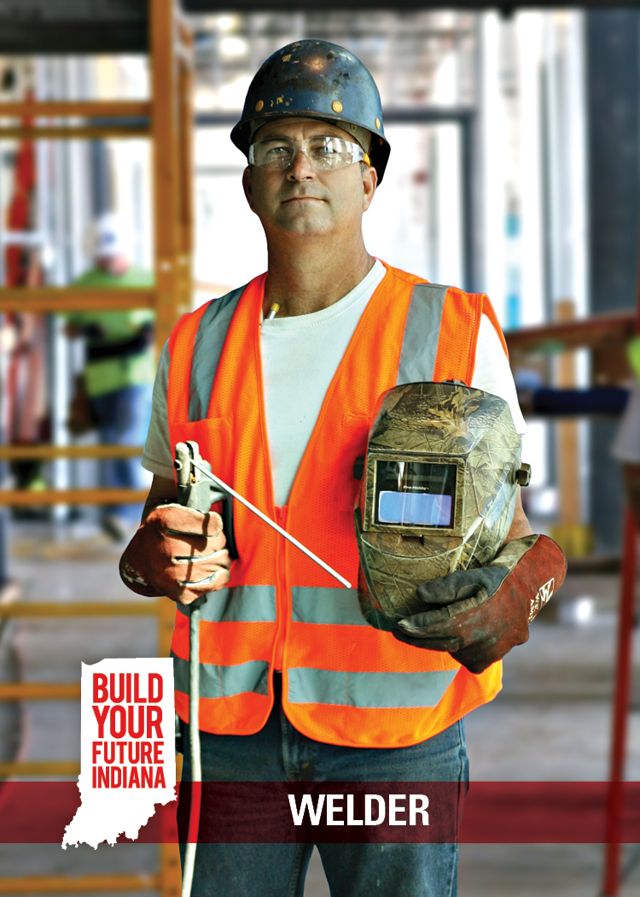
Build It: Welder
Average Salary: $71,067
Description: Join objects together by applying heat or pressure; knowledge of welding principals and metals; use blueprints and drawings to build
Education Options: Technical School, Community College, Registered Apprenticeship Program, and Industry Training Program
Qualifications: Attention to detail, manual dexterity, coordination, ability to read blueprints and drawings
https://youtu.be/BQzERXpnP00

Slide 27
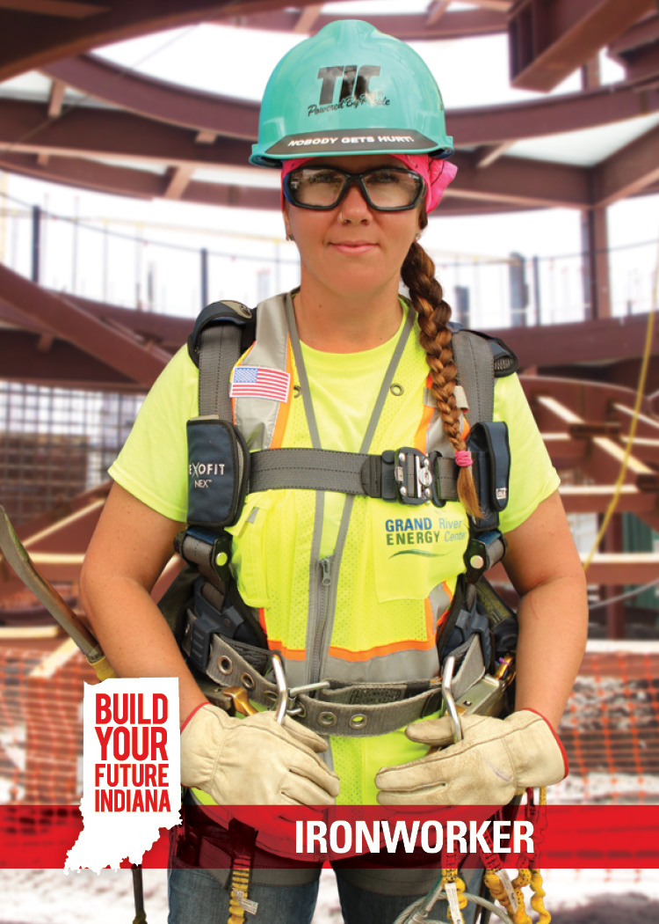
Build It: Ironworker
Average Salary: $60,060
Description: Place and install iron or steel girders, columns, and other construction materials to form structures
Education Options: Technical School, Community College, Registered Apprenticeship Program, and Industry Training Program
Qualifications: Attention to detail, physical dexterity, coordination, good balance and agility, mechanical and mathematic aptitude
https://youtu.be/ELeycZxidWY

